Slide 1


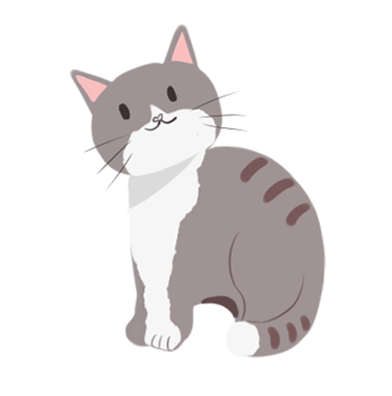
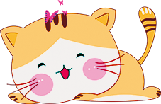
元宵节
Chinese Lantern Festival

Slide 2
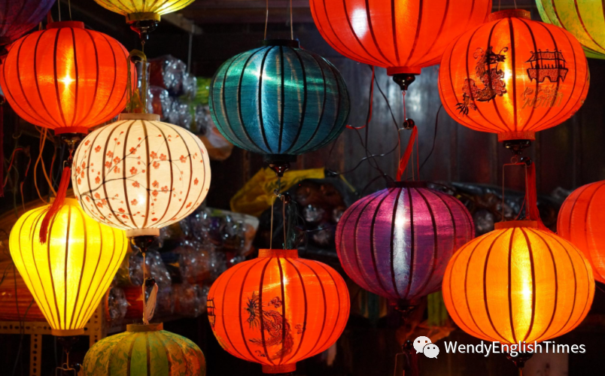
元宵节
On the 15th day of the first lunar month, two weeks after Chinese New Year, another important traditional Chinese festival, the Chinese Lantern Festival is celebrated. It marks the first full moon of the new lunar year and the end of the Chinese New Year period.

Slide 3

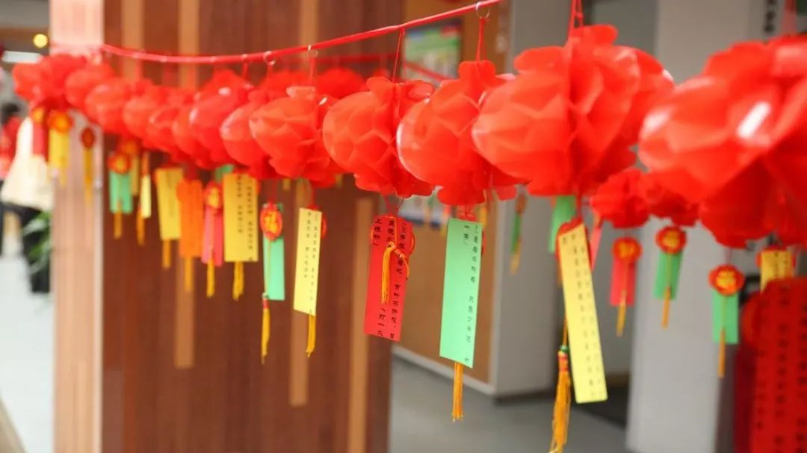
Guessing Lantern Riddles 猜灯谜

Slide 4
Guessing Lantern Riddles 猜灯谜
"Guessing lantern riddles"is an essential part of the Festival. Lantern owners write riddles on a piece of paper and post them on the lanterns. If visitors have solutions to the riddles, they can pull the paper out and go to the lantern owners to check their answer. If they are right, they will get a little gift. The activity emerged during people's enjoyment of lanterns in the Song Dynasty (960-1279). As riddle guessing is interesting and full of wisdom, it has become popular among all social strata.

Slide 5
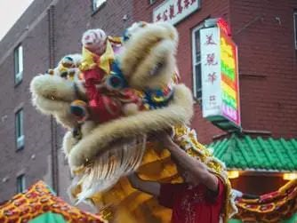
Lion Dance 舞狮子

Slide 6
Lion Dance 舞狮子
According to ancient custom, the lion is a symbol of boldness and strength that can protect people, so by performing the lion dance, everyone prays for an auspicious and happy life.

Slide 7
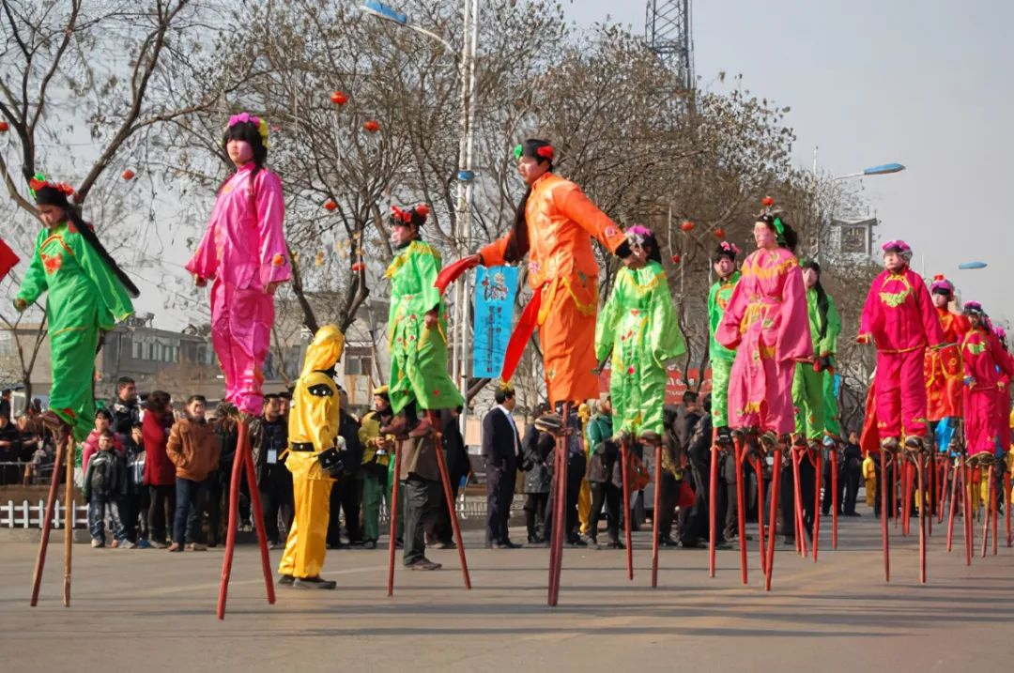
Walking on Stilts 踩高跷

Slide 8
Walking on Stilts 踩高跷
Walking on stilts, another folk art, traces its origins to the Spring and Autumn period (770BC - 476BC). Performers not only walk on stilts by binding them to their feet, but also do some breathtakingly difficult moves. As actors impersonate different characters like monks, clowns, and fishermen and perform vivid and humorous acts, the art amuses many people.

Slide 9
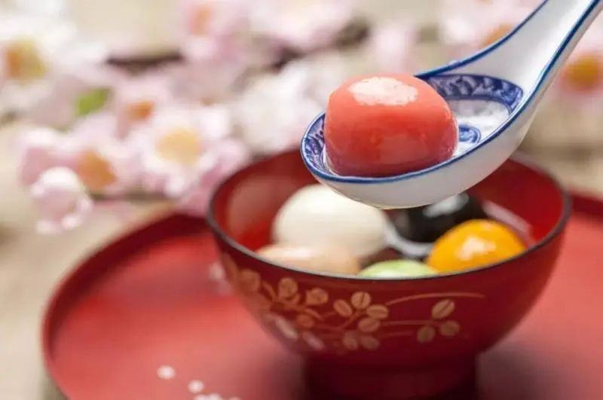
Eating Yuanxiao吃元宵

Slide 10
Eating Yuanxiao吃元宵
Yuanxiao is the special food for the Lantern Festival, which has a similar pronunciation with "tuanyuan" in Chinese, meaning reunion, harmony and happiness for the family.

Slide 11
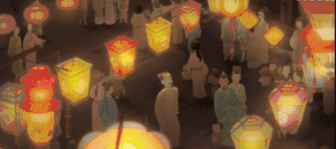
赏花灯Lighting lanterns

Slide 12
赏花灯Lighting lanterns
Decorating and hanging lanterns is the main tradition of the festival, with lanterns big and small hung around households, parks, streets and other public spaces. Red lanterns of various shape and type will attract countless visitors to watch.

Slide 13
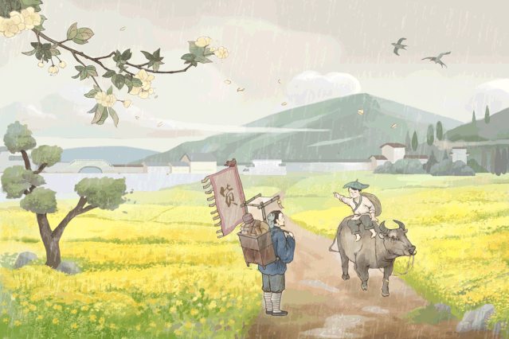
清明节相关英文词汇
Cold Food Festival 寒食节
Day of sacrifice 祭祀节日
Condolence 哀悼之情
Hell note/Joss paper 纸钱
Mourning ceremony 哀悼仪式
Offer sacrifices to ancestors 祭祖/上供
Funeral supplies/products 殡葬用品
Funeral services 殡葬服务业

Slide 14
清明节相关英文词汇
Cold Food Festival 寒食节
Day of sacrifice 祭祀节日
Condolence 哀悼之情
Hell note/Joss paper 纸钱
Mourning ceremony 哀悼仪式
Offer sacrifices to ancestors 祭祖/上供
Funeral supplies/products 殡葬用品
Funeral services 殡葬服务业

Slide 15
THANK YOU

