Slide 1


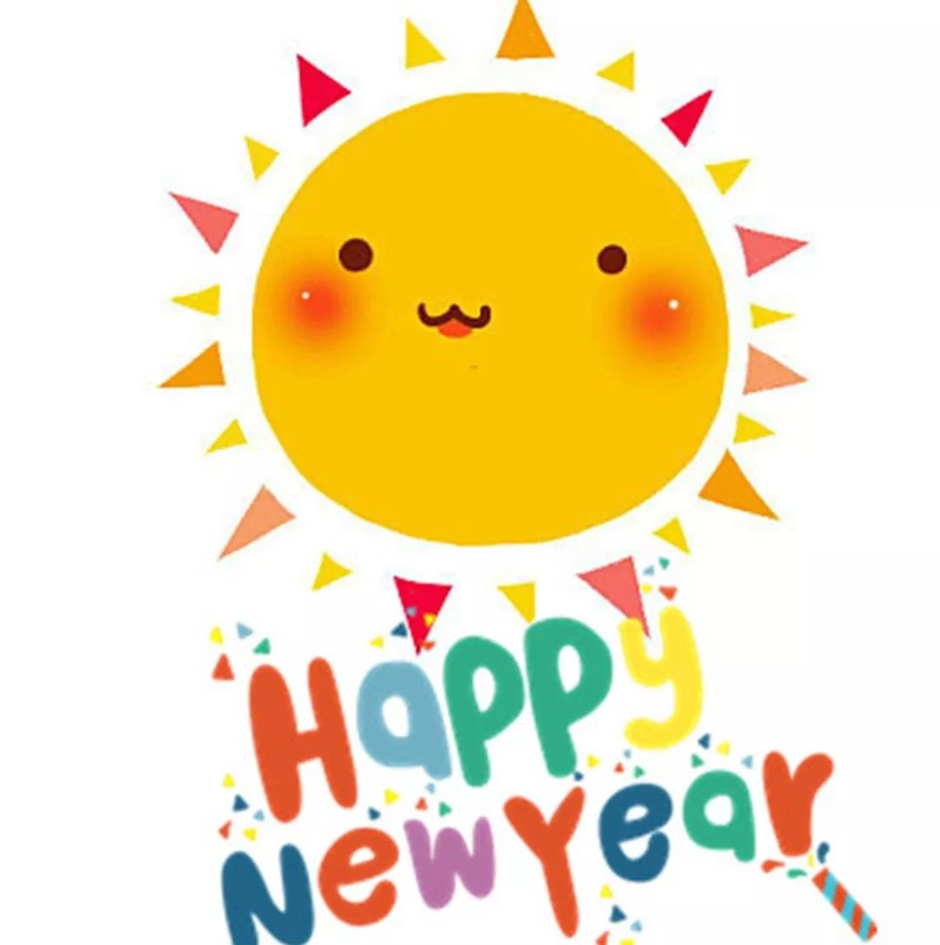
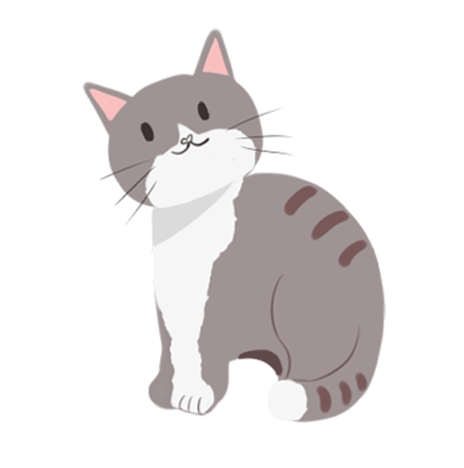
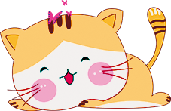
除夕夜
Chinese New Year's Eve

Slide 2
About Chuxi 除夕简介
Chuxi，or the Chinese New Year's Eve, is a traditional Chinese holiday celebrated on the last day of the 12th month of the the Chinese lunar calendar. Homes are spotless in and out, doors and windows are decorated with brand new Spring Festival couplets, New Year's pictures, hangings, and images of the Door God, and everyone dresses up in new holiday clothes that are decorated with lucky patterns and auspicious colors.

Slide 3
Traditions and Customs 传统与习俗
Chinese New Year's Eve’s practice is the cluster of this festival’s history and tradition for thousands of years. There are many practices in China which are varied as people in different regions have different customs. Most of the practices exists for thousands years and still being used nowadays.

Slide 4
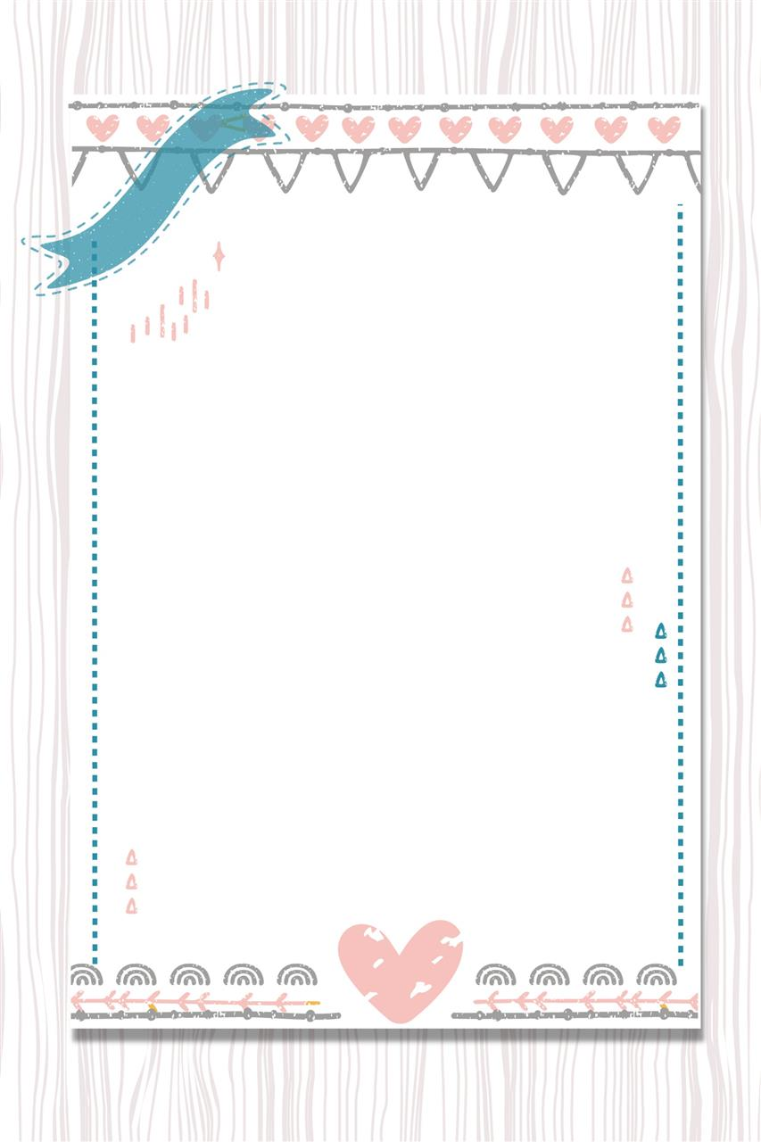
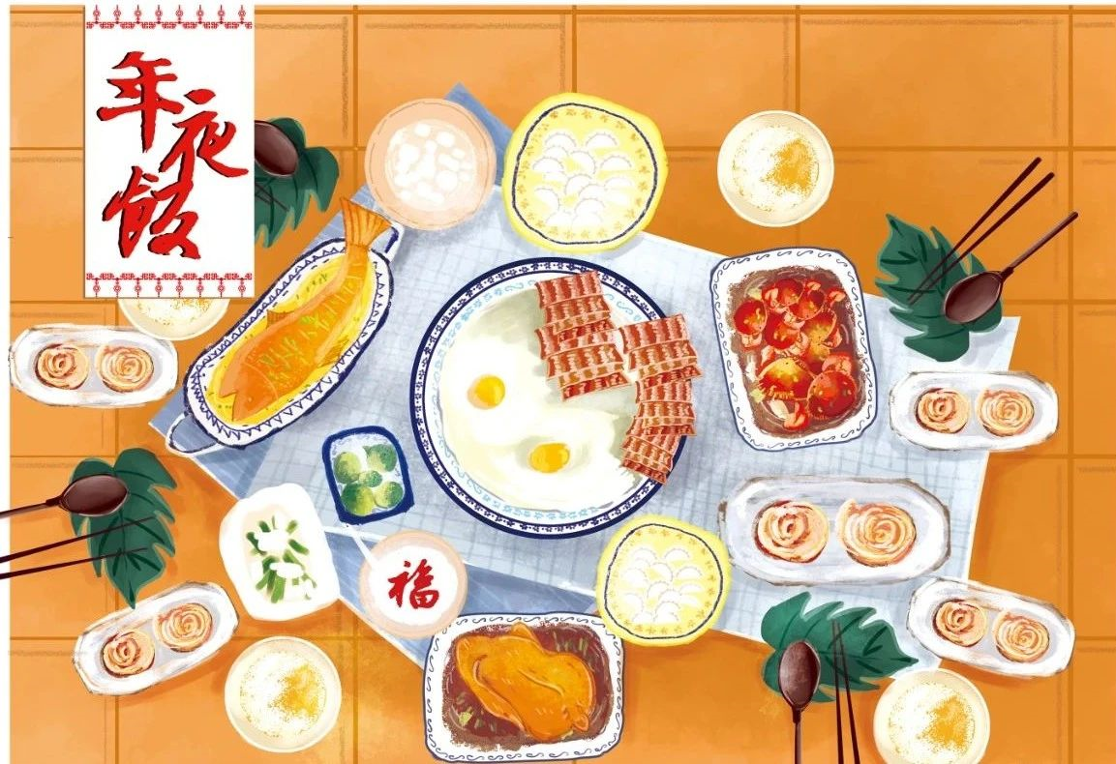
Gathering 家人团聚

Slide 5
Gathering 家人团聚
In China, people are used to having grand family banquets to celebrate Chinese New Year's Eve which is known as “Happy gathering”. Since it is the last meal of the year, all the family members must sit together to enjoy the delicious family traditional dishes. To Chinese, New Year's Eve dinner is more than just enjoying a grand feast. The elaborate dinner is laden with auspicious food. The names of the dishes express the wish for good luck in the coming year. On this day, all Chinese all over the world, no matter how far away from home they are or how busy at work, will be home for dinner.

Slide 6
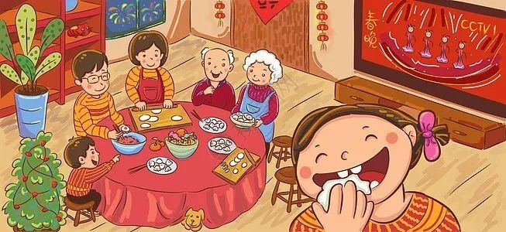
Watching the Spring Festival Gala

Slide 7
Watching the Spring Festival Gala
The Spring Festival Gala is a TV show which broadcasts live by China's Central Television on Lunar New Year’s Eve with singing, dancing, sketch comedy and cross-talk. It has been institutionalized as a crucial practice of Chinese New Year’s Eve, every family member sits in front of the TV, watching the Spring Festival gala together.

Slide 8
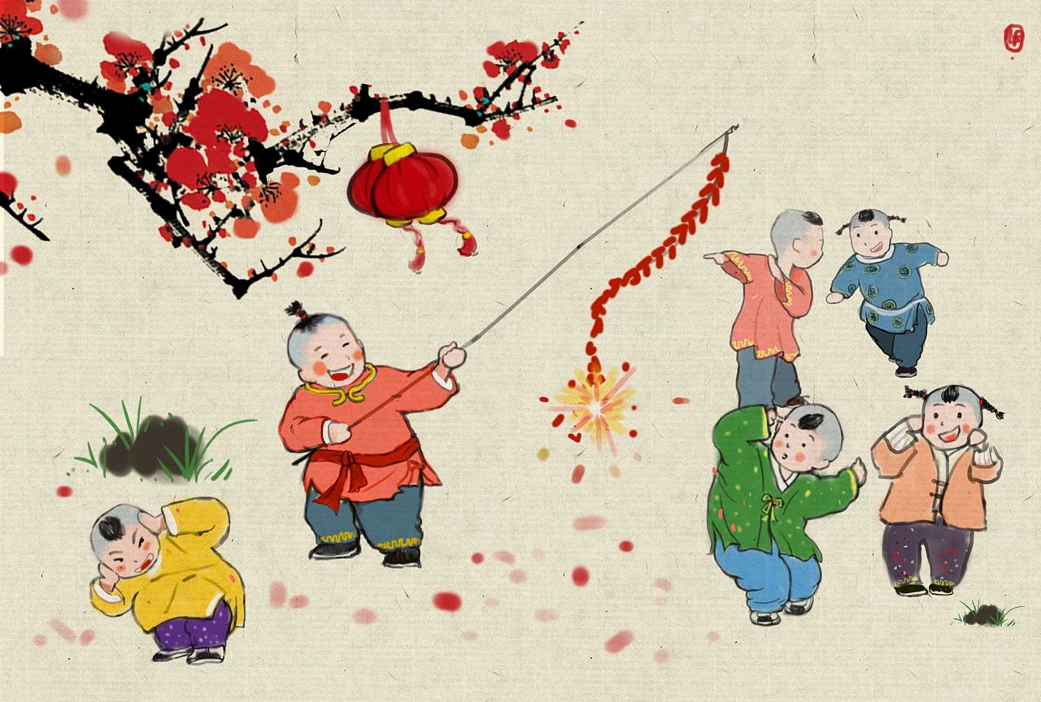
Letting off Firecrackers 放鞭炮

Slide 9
Letting off Firecrackers 放鞭炮
Legend has it that long ago during the age of great floods, there was a vicious monster named Nian. Whenever the last day of the 12th lunar month arrived, this monster would appear, and killed many people. Later, people accidentally discovered that the monster was afraid of the sound of burning bamboo. So Chinese will burn bamboo to make the sound to keep the devil out of their house on Chinese New Year's Eve. Nowadays, Chinese people still like to light firecrackers instead of bamboo on the Chinese New Year's Eve.

Slide 10
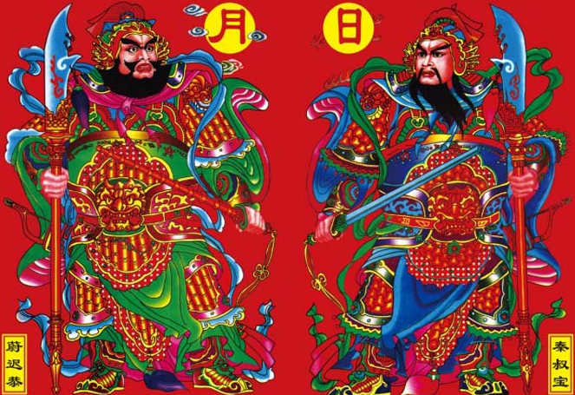
Inviting the Door God 请门神

Slide 11
Inviting the Door God 请门神
Every year on New Year's Eve, people paste up images of the Door God on their doors. The Door God, or guardian of the threshold, is a very old deity. In addition to door gods, images of the gods of Blessings, Prosperity, and Longevity, as well as the Ten Thousand Deities and the Three-Treasures Buddha, are often hung in living rooms and bedrooms. These guardian deities were thought to protect the household from evil influences and repel demons.

Slide 12
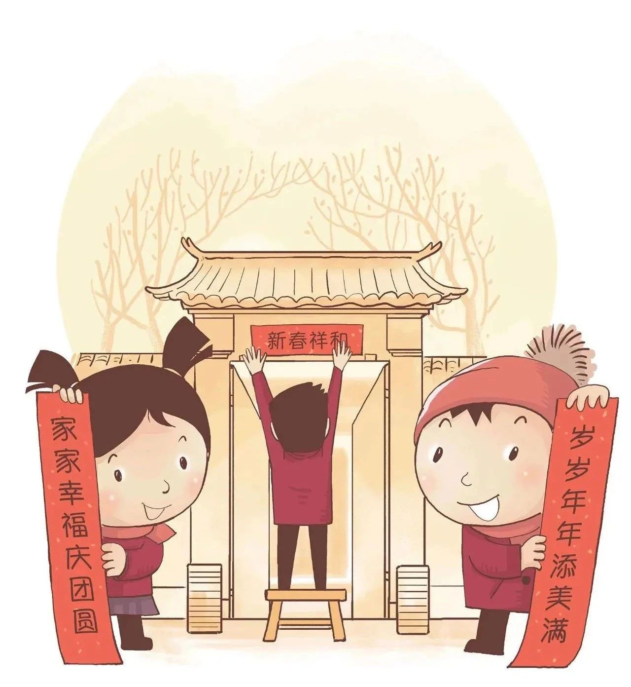
Hanging Spring Festival Couplets

Slide 13
Hanging Spring Festival Couplets
Hanging Spring Festival Couplets, or Chunlian in Chinese, is a common and important custom when celebrating the Chinese New Year. As a tradition, Chinese people write couplets, a two-sentence, auspicious poem written on red couplets in anticipation of a prosperous Lunar New Year. The tradition is widely kept in modern cities and rural areas of China, and overseas Chinese communities.

Slide 14
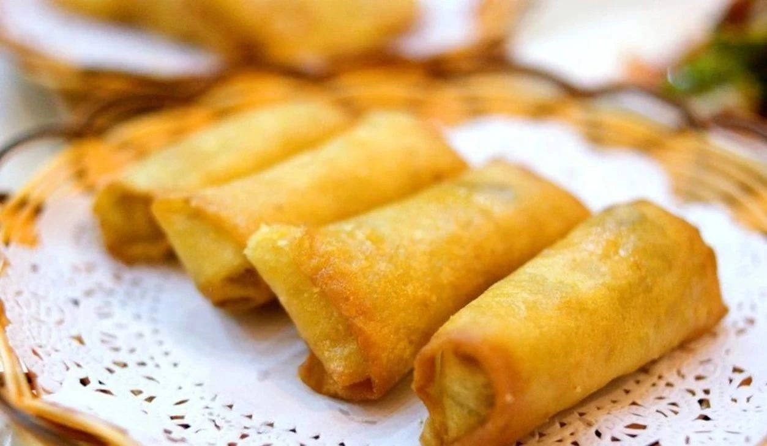
Spring rolls 春卷

Slide 15
Spring rolls 春卷
Spring rolls are a traditional dish in Eastern China. People make the thin dough wrappers in the cylindrical-shaped rolls and fill them with vegetables, meat, or something sweet, then fried the spring rolls to give them a golden-yellow color.

Slide 16
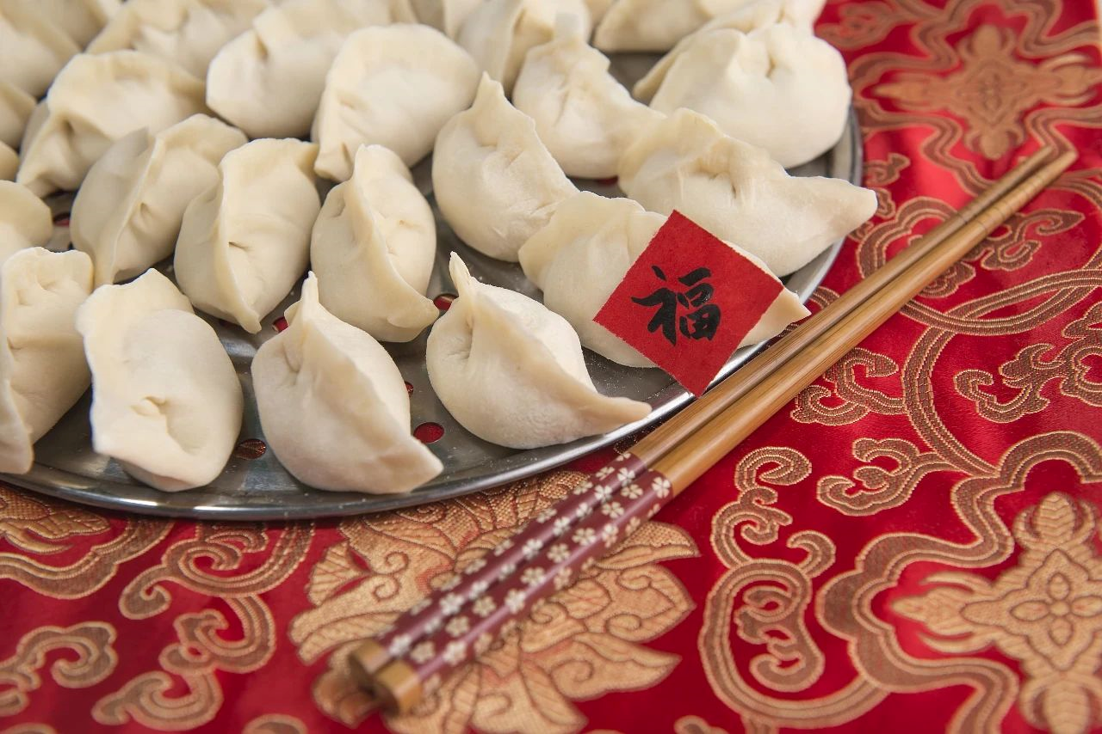
Dumplings 饺子

Slide 17
Dumplings 饺子
Dumplings，or jiaozi in Chinese, are a traditional food to eat in northern China on Chinese New Year’s Eve. Minced meat and vegetables are wrapped in the elastic dough skin. Boiling, steaming and frying are the most common ways to cook dumplings in China.

Slide 18
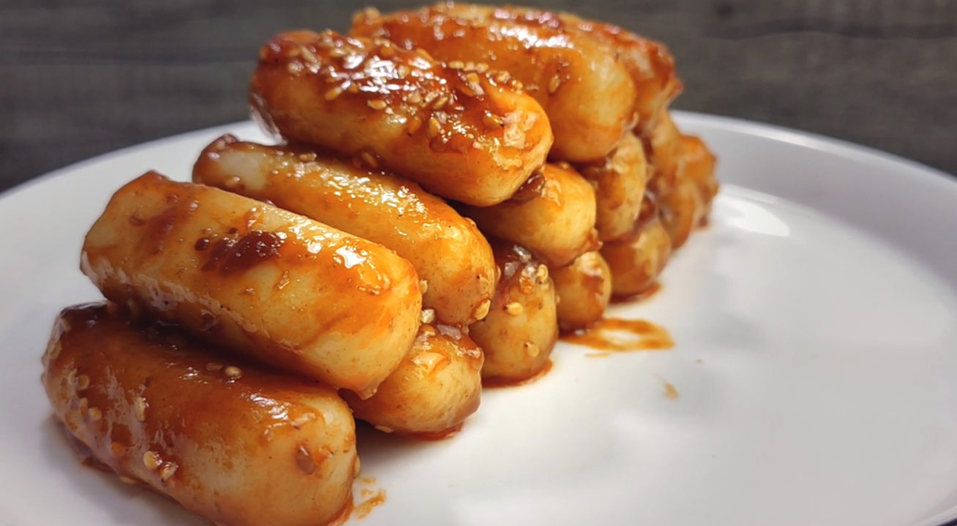
Glutinous rice cakes 糯米糕

Slide 19
Glutinous rice cakes 糯米糕
Glutinous rice cakes are called "niangao" in Chinese. The sound of niangao has a good meaning: getting higher year by year. Niangao is made of sticky rice, sugar and chestnuts. It is a common dish which appears in the Chinese families' Lunar New Year Eve reunion dinner.

Slide 20
相关词汇
the Chinese New Year's Eve 除夕
auspicious 吉利的，吉祥的
the Spring Festival Gala 春节晚会
firecracker 鞭炮
Door God 门神
Spring Festival Couplets 春联
spring roll 春卷
dumpling 饺子
glutinous rice cake 糯米糕，年糕

Slide 21
关于除夕美好祝愿的英文表达
岁岁平安 Everlasting peace year after year
恭喜发财 Wishing you prosperity
吉祥如意 Everything goes well
一帆风顺 Wishing you every success
步步高升 Promoting to a higher position
和气生财 Harmony brings wealth
心想事成 May all your wishes come true

Slide 22
常见拜年祝福语
Treasures fill the home 金玉满堂
Business flourishes 生意兴隆
Peace all year round岁岁平安
Wishing you prosperity恭喜发财

Slide 23
常见拜年祝福语
May all your wishes come true 心想事成
Everything goes well 吉祥如意
Wishing you every success一帆风顺
Promoting to a higher position 步步高升
Safe trip wherever you go 出入平安

Slide 24
THANK YOU

