Slide 1
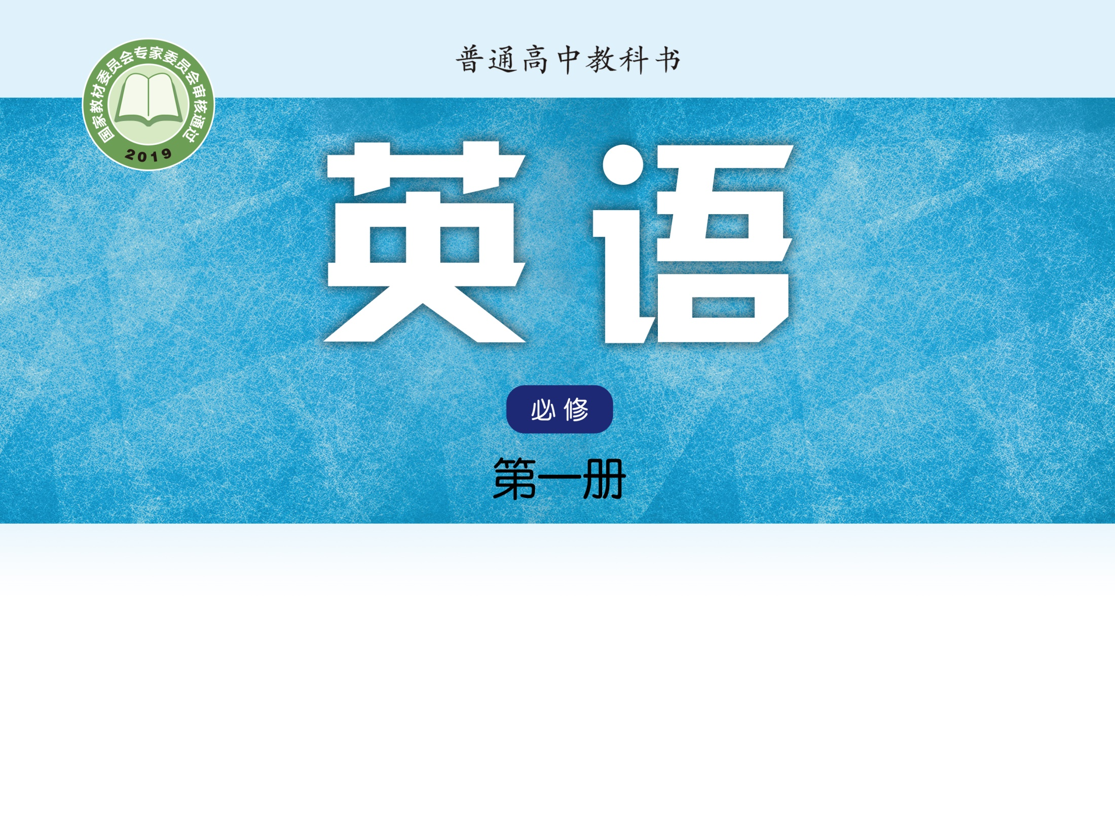
Unit 2 Let’s talk teens
Welcome to the unit & Reading (I)

Slide 2
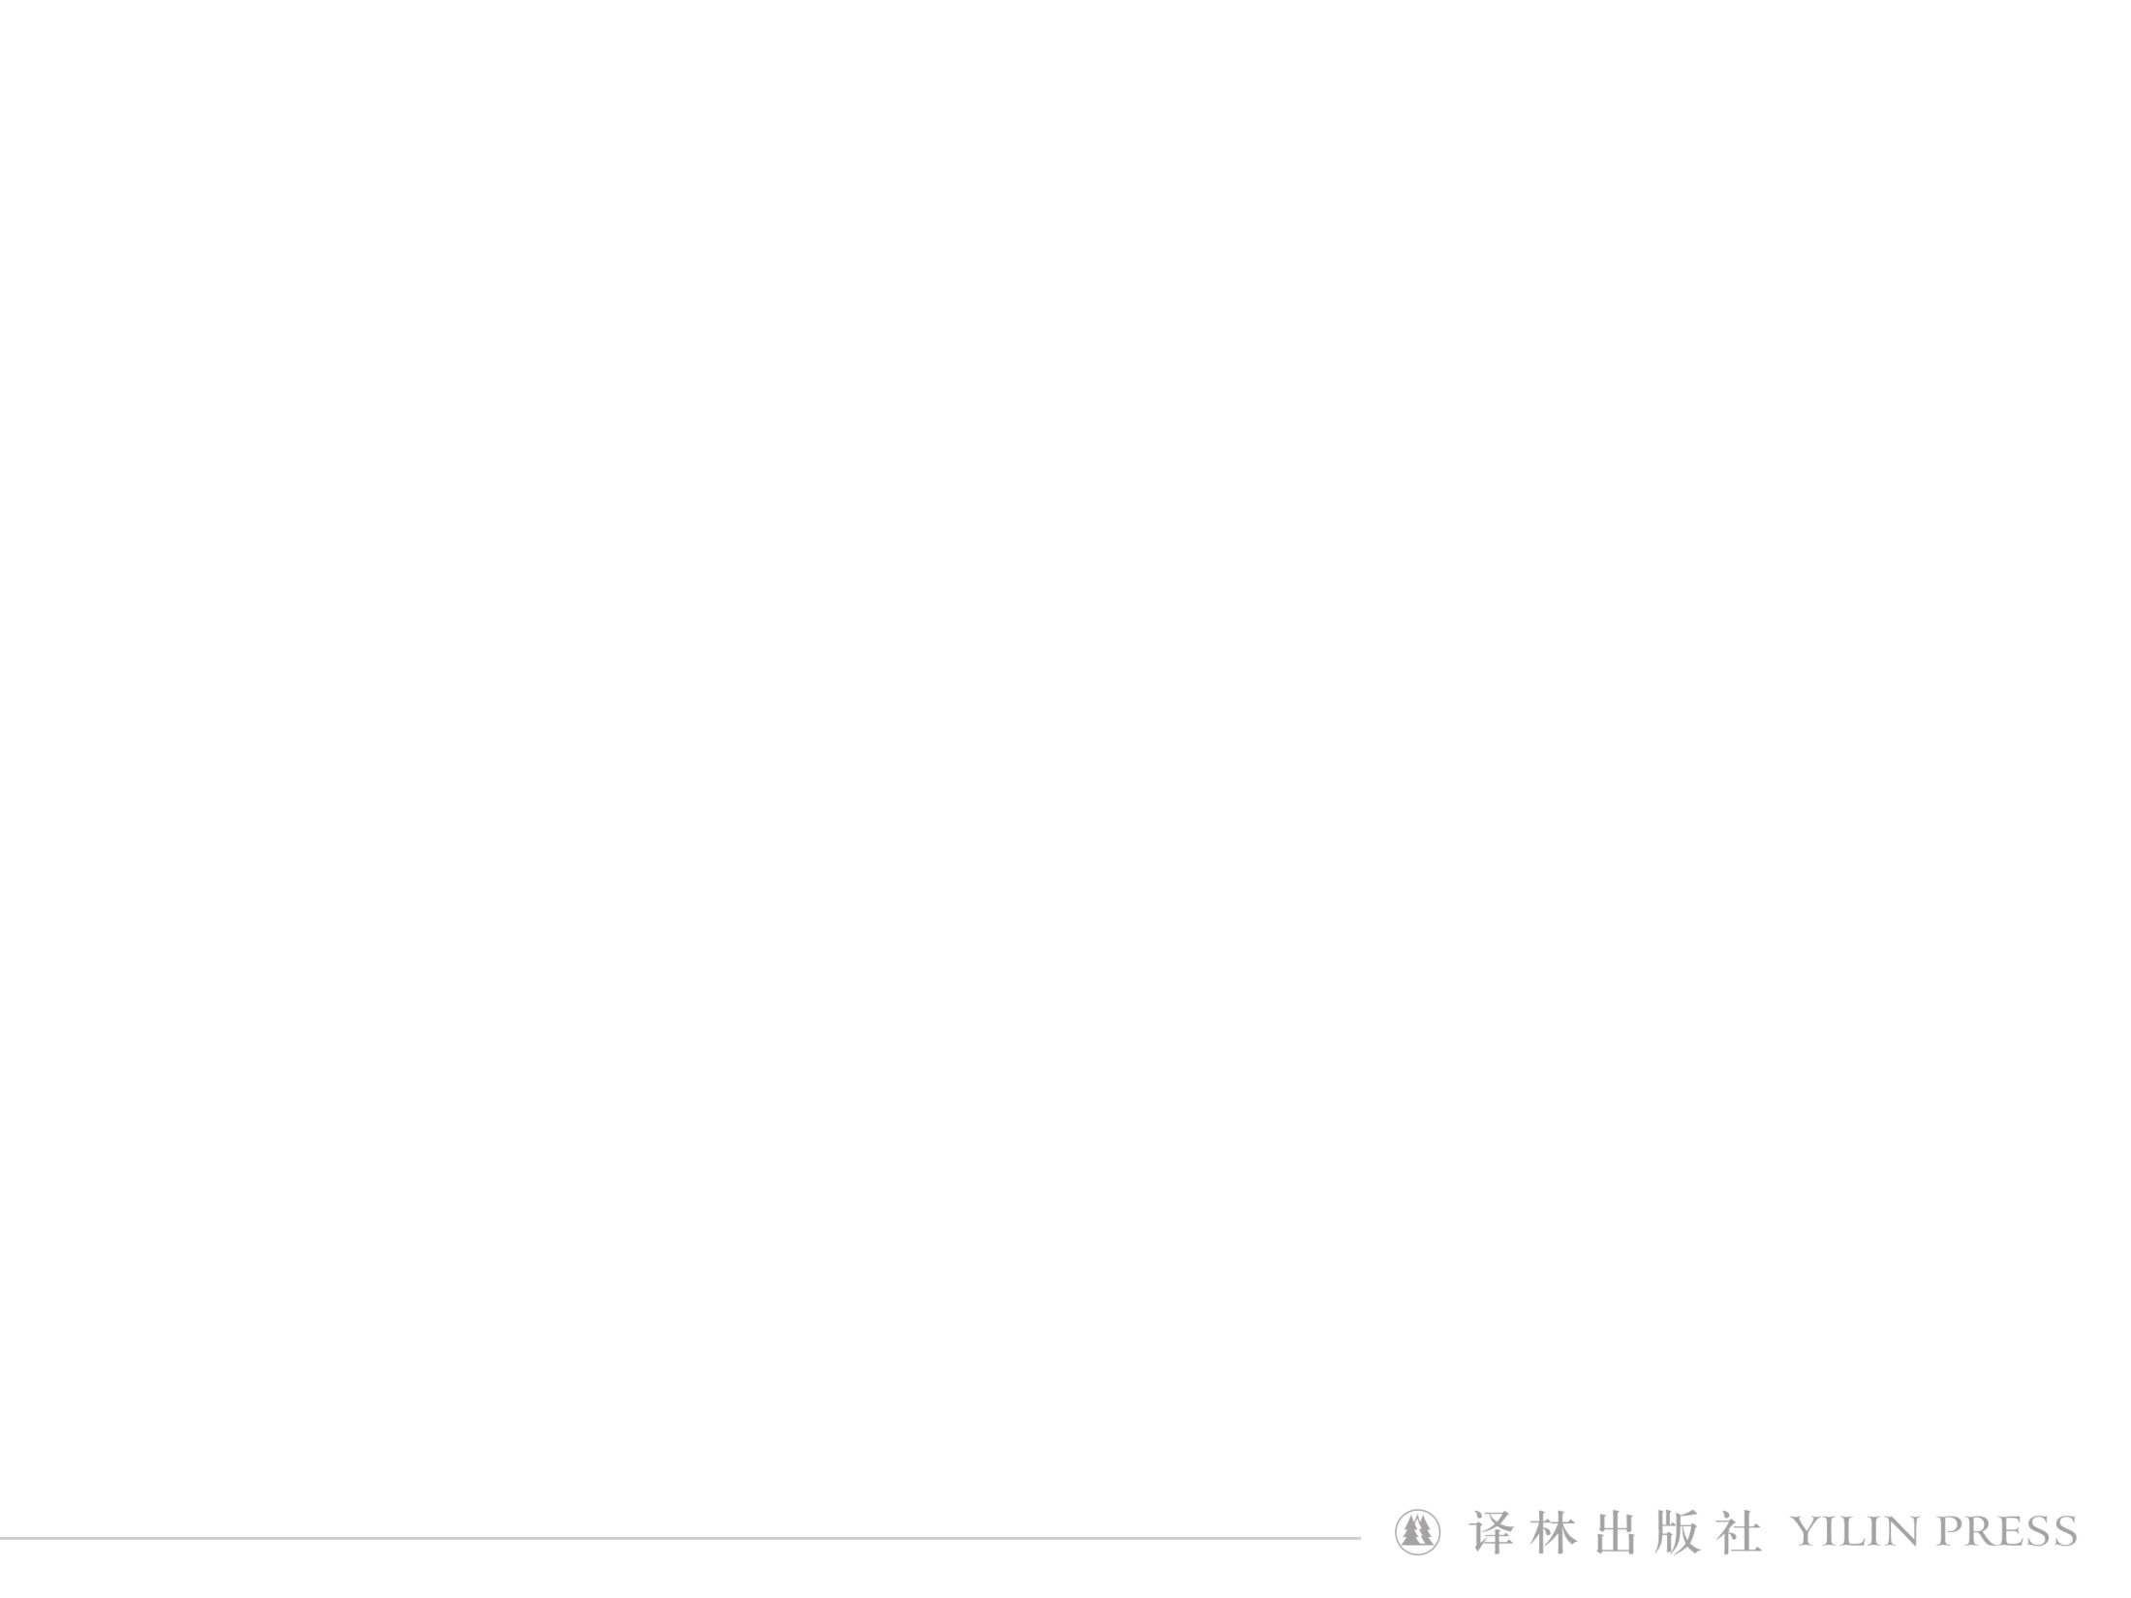

Appreciation
I don’t know what “home” is, but unhappiness and worries melt away once there.
－Bing Xin
What’s the definition of “home” to you?

Slide 3
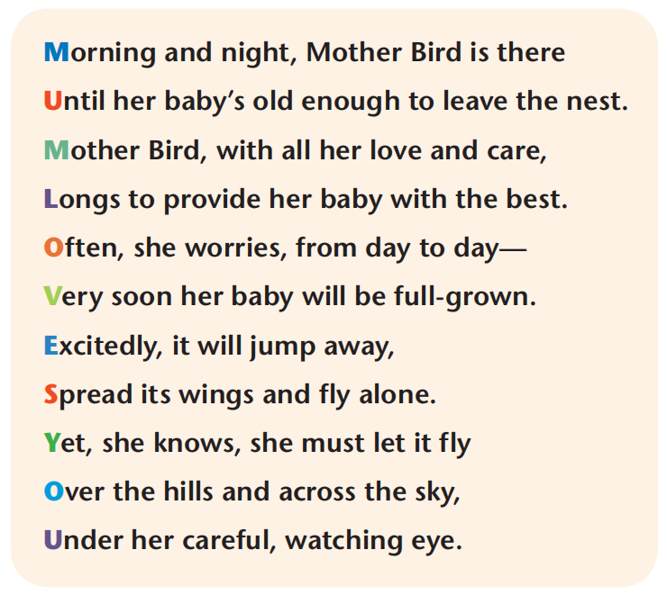
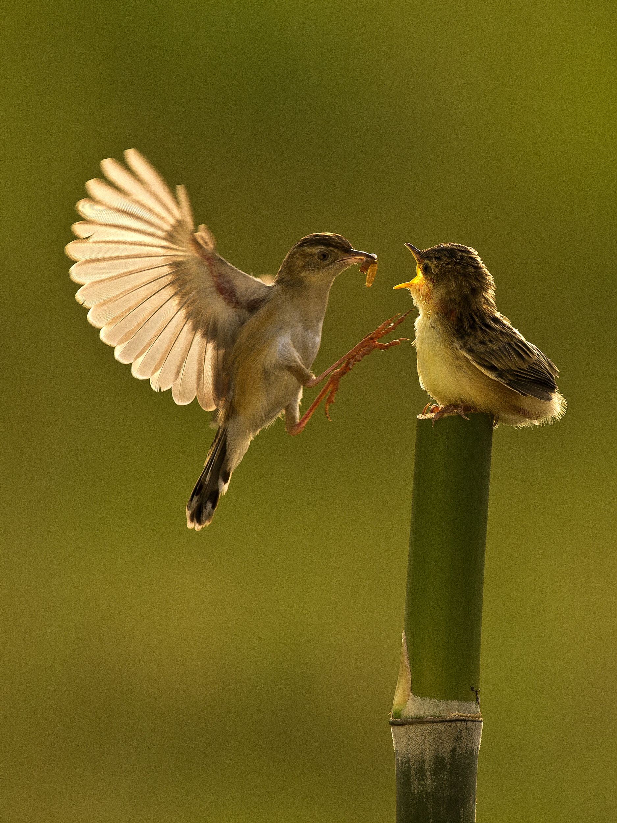
Describe Mother Bird’s feelings in the poem.

Slide 4
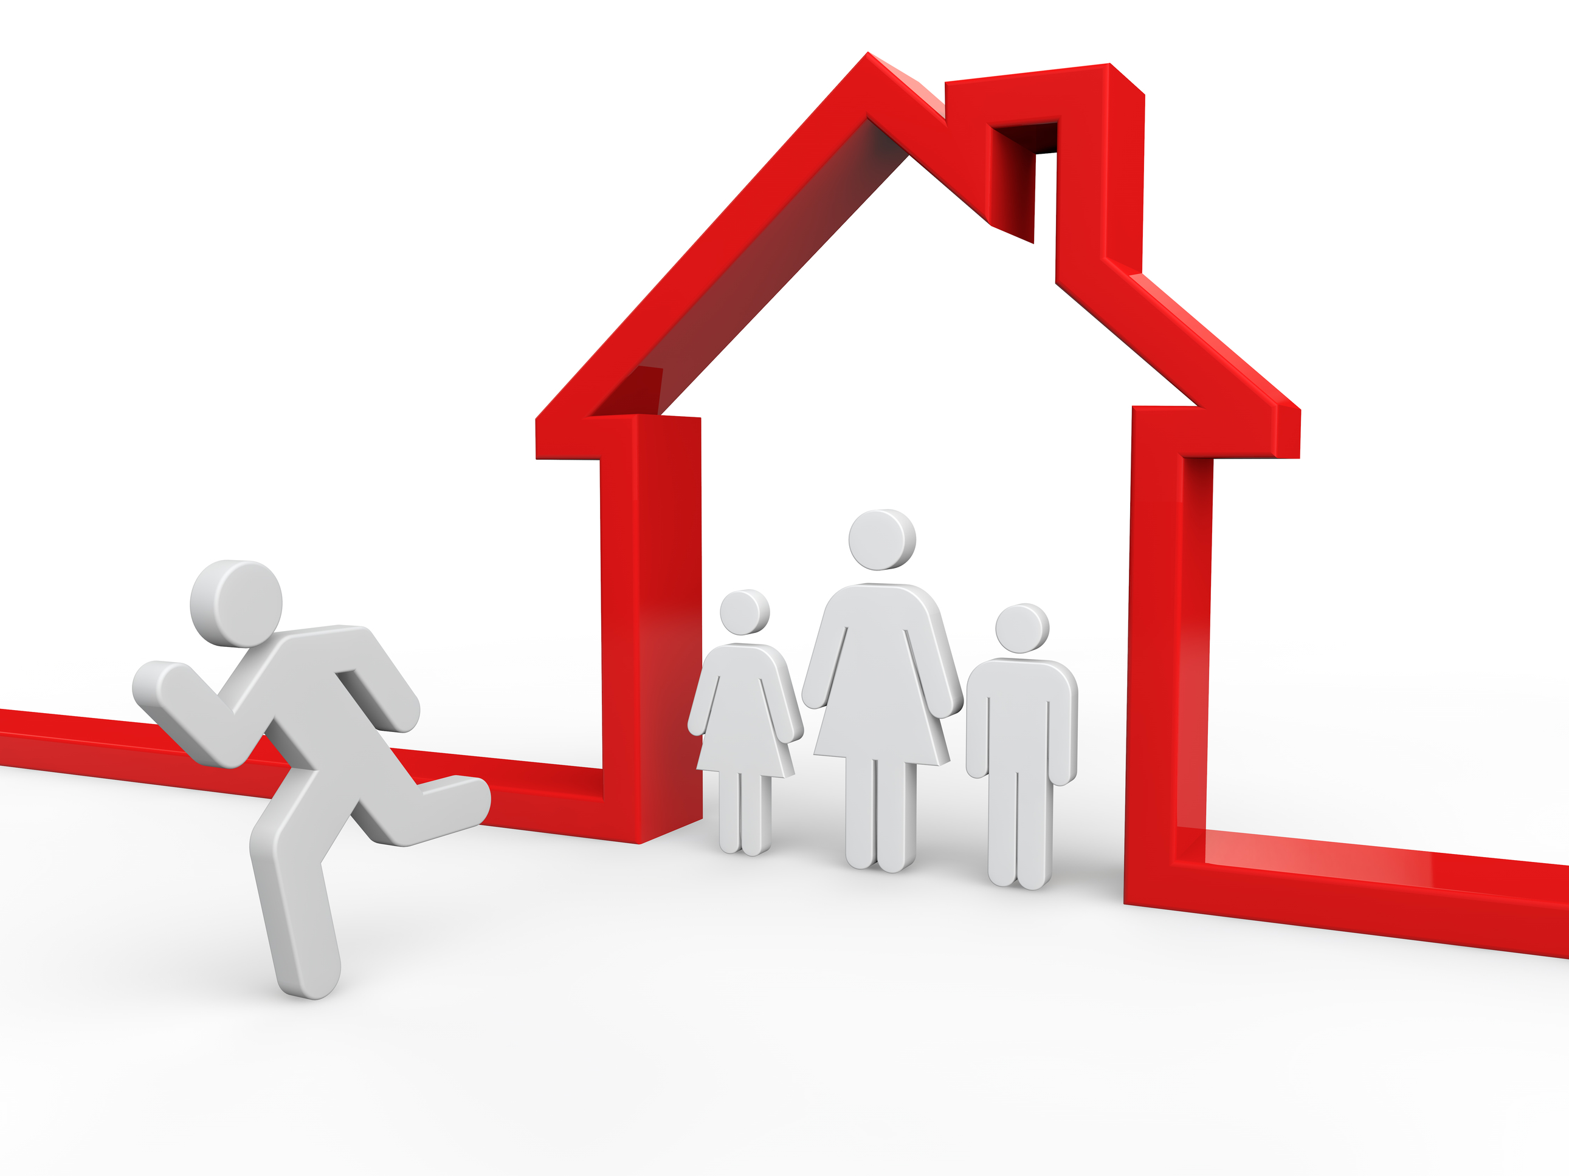
Comparison
Song of the Parting Son
A thread in one hand of the loving mother,
A dress of the parting son in the other.
She sews stitch by stitch: his departure’s near,
For fear that he won’t be home in many a year.
Who can tell, how much should the son impart
To well reward the loving mother’s heart?
Guess the name of the poem.
What similarities do the two poems have?

Slide 5
Love
Expectations
Patience
Concerns
Independence
Freedom
Eagerness
Gratitude
Are you always happy with your parent’s
unconditional love?

Slide 6
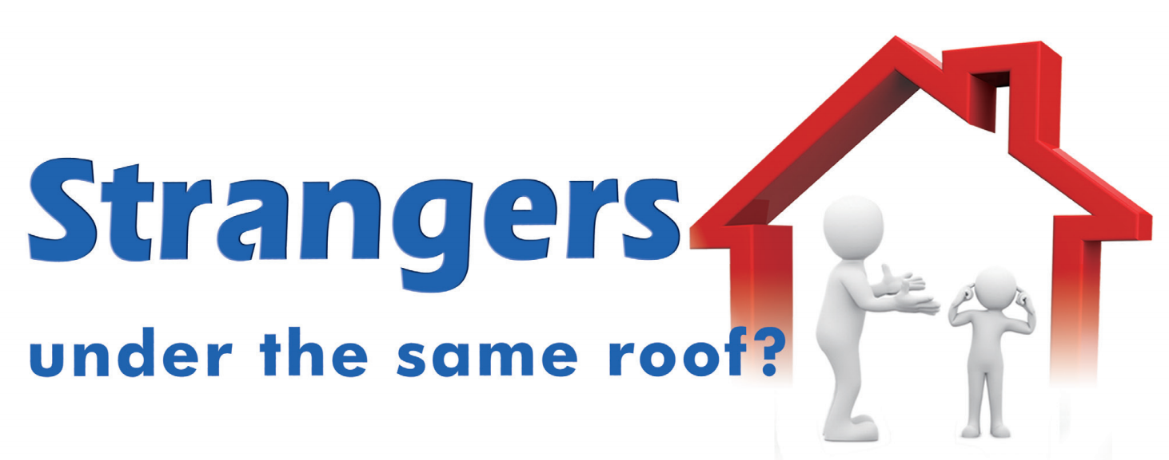

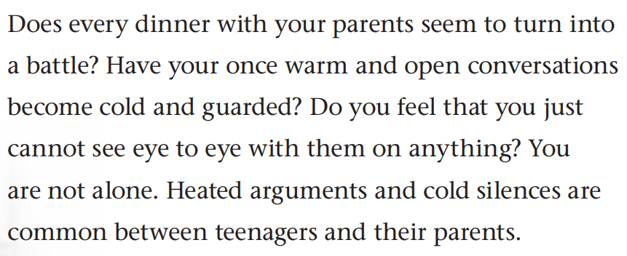
Magazine article

Slide 7
Creative reading
Title + Picture + Para. 1
Understanding of the title: ________________
Theme: _______________________________
Purpose of asking questions: ______________
Genre: ________________________________
Target audience: ________________________
Prediction of the contents: ________________

Slide 8
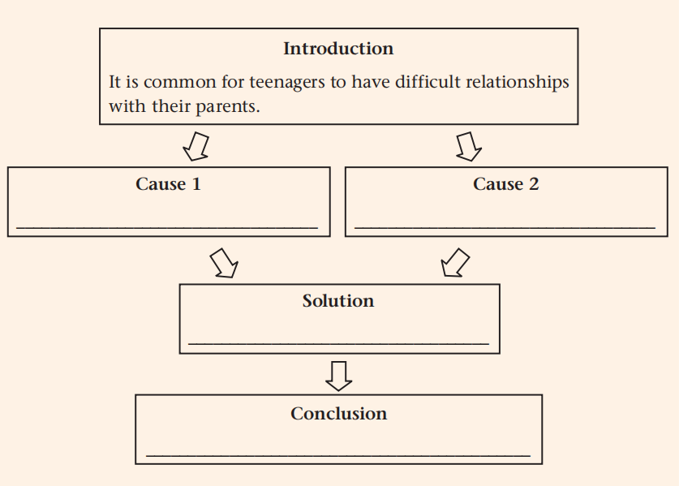
Global reading
Teenagers' physical growth may result in such family tensions.
Teenagers’ developing mental needs can also influence parent-child relationships.
Teenagers should have regular and honest communication with their parents.
Everything will turn out all right in the end.

Slide 9
Structure of an argumentative essay
Introduces the topic and state the focus of the essay
Para. 1
Analyze the causes of parent-child tensions
Paras. 2 and 3
Offers some solutions to this problem
Para. 4
Para. 5
states the conclusion and shows opinions about the topic

Slide 10
In-depth reading
Cause 1
_____________
height
voice
weight
spots
Physical changes

Slide 11
Cause 2
____________________
Mental needs
Childhood
Adolescence
Adulthood
love/support
independence
disagree
be careless
be impatient
take responsibilities
make decisions
control feelings

Slide 12
On the one hand
It can be a big headache to balance your developing mental needs too. You enter a strange middle ground—no longer a small child but not quite an adult. You have both a new desire for independence and a continued need for your parents’ love and support. You feel
ready to be more responsible and make decisions on your own. Unfortunately, your parents do not always agree and that makes you feel unhappy. “Why can’t they just let me go?” you may wonder.
On the other hand, when you are struggling to control your feelings, you wish they could be more caring and patient—sometimes
they forget that growing up is a rough ride. It can be difficult when your parents treat you like a child but expect you to act like an adult. All of this can lead to a breakdown in your relationship.

Slide 13
Solution
___________________
1. Take a minute to __________________.
2. Try to understand the situation ________.
3. ____________ your actions and feelings.
4. _______________ carefully and address
their ________.
Show empathy for each other
Learn to compromise
Regular and honest communication

Slide 14
Critical reading
Conclusion
____________________
Childhood
Adolescence
Adulthood
normal
temporary
take responsibilities
make decisions
control feelings
The writer’s attitude to parent-child tensions: __________
Supporting sentences:_____________________________
The writing purpose: _____________________________
Significance of healthy parent-child relationships: ______

Slide 15
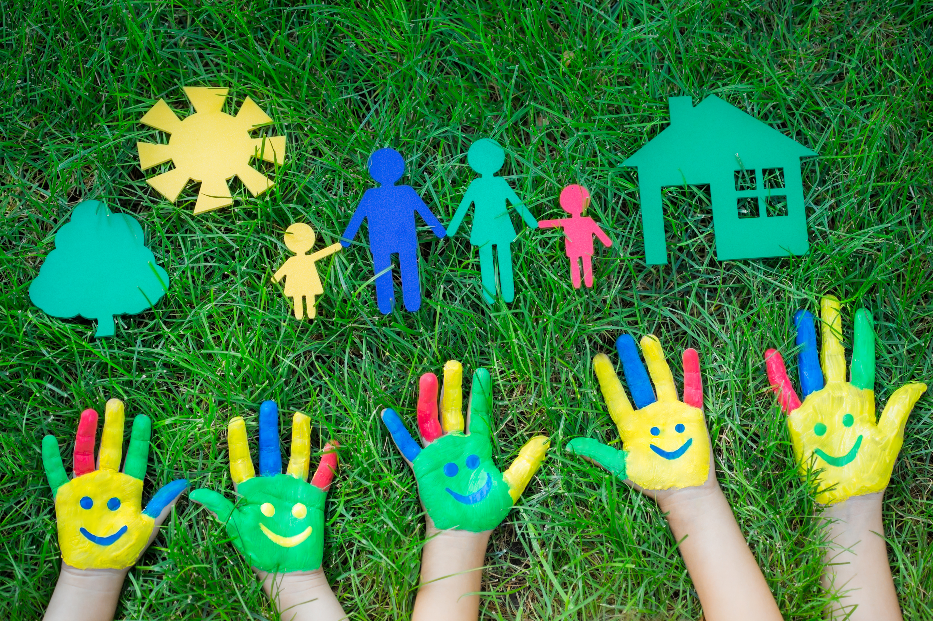
Adolescence
Adulthood
Healthy parent-child relationships
Healthy
interpersonal relationships
Healthy
marriage relationships

Slide 16
Post-reading
The writer suggests that teenagers want both independence and their parents’ love and support. Do you feel the same way? Why or why not? Give an example.
Cooperate with your partners and create a situation where you successfully solve the conflicts with your parents by following the writer’s advice.

Slide 17
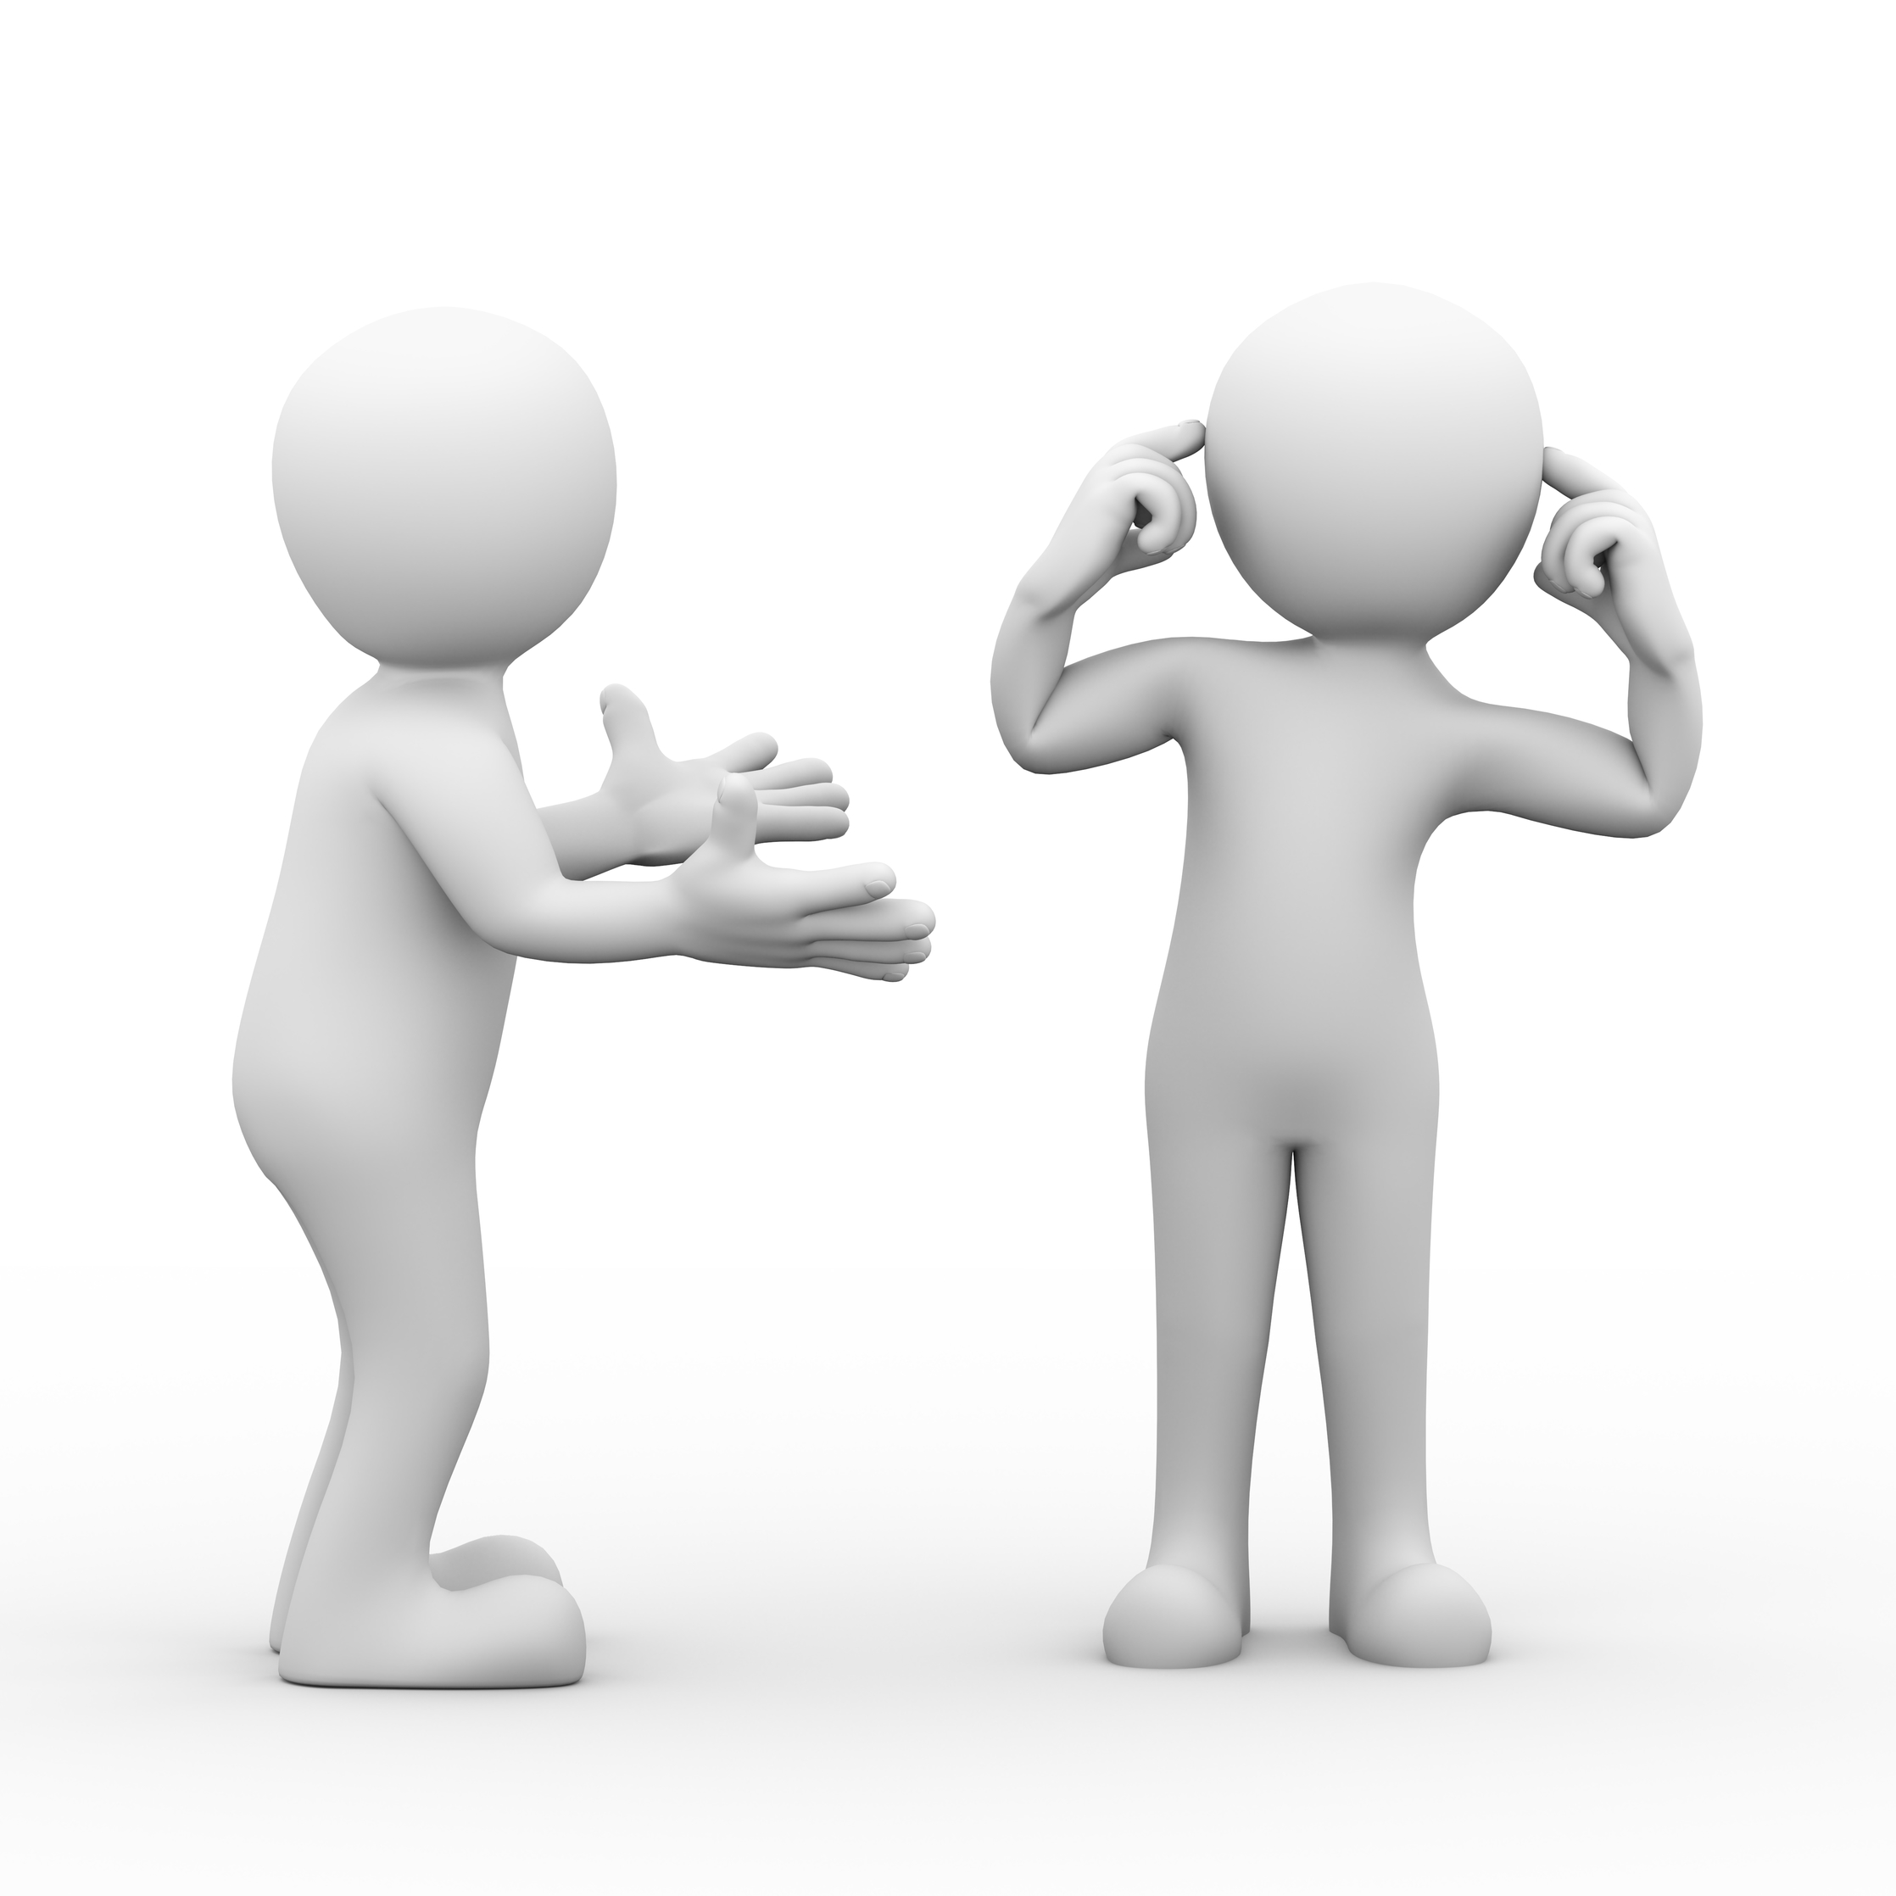
Homework
Collect words or phrases related to parent-child tensions in the magazine article.
Choose one paragraph and analyze its structure.
Write a summary of the magazine article (within 60 words).

Slide 18

My words/phrases
Words and phrases related to problems:
_______________________________________
Words and phrases related to cause and effect: _______________________________________
Words and phrases related to feelings: _______________________________________
Words and phrases related to solutions: _______________________________________
Linking words and phrases:
_______________________________________

Slide 19
My analysis of paragraph structure
____________________________________
____________________________________
____________________________________
My summary
____________________________________________________________________________________________________________

Slide 20
