Slide 1

Unit 1 Back to school
Grammar and usage

Slide 2

Link the words into a sentence
Miss Yan to was excited to the opportunity give be given really a speech.
Miss Yan was really excited to be given the opportunity to give a speech.

Slide 3
Exploring the rules
Subject | Verb
I | agree.
Subject | Verb | Predictive
Subject | Verb | Object
Subject | Verb | Indirect object | Direct object
Subject | Verb | Object | Object complement
These habits
will be
helpful.
You
will have
a happy life.
Setting goals
gives
you
a focus in life.
Setting goals
makes
you
more confident.

Slide 4
Working out the rules
Subject + Verb (SV)
Subject + Verb + Predicative (SVP)
Subject + Verb + Object (SVO)
Subject + Verb + Indirect object + Direct object (SVOO)
Subject + Verb + Object + Object complement (SVOC)
verb
Rule 1: The subject and the ________ are necessary parts of a sentence.

Slide 5
S + V + O
I agree.
You will live a happy life.
Subject
Intranstive verb (vi.)
Subject
Transtive verb (vt.)
Object
Rule 2: A transitive verb is always followed by a(n) _________. Objects are usually _______ or ____________.
object
nouns
pronouns

Slide 6
S + V + O
Practice
Complete the following sentences with proper verbs or objects.
1. During the three years of senior high school, I
________ great knowledge and ________ personal growth.
2. In order to improve my football skills, I will
join ______________.
3. To achieve my goal for the new term, I will
learn ______________. (to-infinitive serving as object)
acquired
enjoyed
a football club
to play football

Slide 7
S + V + DO + IO
You will have a happy life.
Setting goals gives you a focus in life.
Setting goals gives you a focus in life.
Setting goals gives a focus to you in life.
Rule 3: Some verbs can have two objects. The indirect object usually refers to a person and the direct object a thing.

Slide 8
S + V + DO + IO
Practice
1. Brainstorm.
What verbs have we learned that can take two objects?
? sb. sth.
2. Make sentences using S+V+IO+DO structure.
e.g. Joining a school club offers me a good opportunity to learn new skills.
____________________________________
____________________________________

Slide 9
S + V + O + OC
Object complement (OC)
Setting goals makes you more confident.
Rule 4: The object complement adds more information about the object.

Slide 10
S + V + O + OC
Practice
Complete the following sentences with proper object complements.
1. Mrs. Barrow named her dog ________.
2. I wanted to paint my bedroom _______.
3. I smelled something _______ in the kitchen.
4. The terrible news left us ____________.
5. I watched a magician _______________ on TV.
6. Our principal encouraged us ____________________.
Bluebell
pink
burning
in great shock
perform a magic
to fully realize our potential

Slide 11
or
?
S+V+O
S+V+P
1. We should keep positive in life.
2. We should keep a positive attitude to life.
3. Achieving a balance between my study and hobbies remains a challenge.
S+V+P
S+V+O
S+V+P
should keep
The verbs in the above sentences are ___________, _________and ________.They each belong to the ________ verb, the _________ verb and the _________ verb.
should keep
remains
linking
transitive
linking

Slide 12
or
?
S+V+O
S+V+P
Linking verbs include _______ verbs and verbs like __________________________________________________________________________________________.
A word or a group of words that follows a linking verb is _________________ .
be
look, sound, taste, smell, feel
get, become, turn, stay, remain, keep, etc
the predicative (P)

Slide 13
or
?
S+V+O
S+V+P
1. We should keep positive in life.
2. We should keep a positive attitude to life.
3. Achieving a balance between my study and hobbies remains a challenge.
S+V+P
S+V+O
S+V+P
Question: How can we decide the verb in a sentence is a linking verb, a transitive or an intransitive verb?
Tip: Change the verb into “be” verb. If the sentence still makes sense, the verb is a linking verb.

Slide 14
Adverbials
We can add an adverbial to each of the above five sentence structures. We use an adverbial to show when (adverbial of time), where (adverbial of place) or how (adverbial of manner) an action is done.
We watched our chemistry teacher do an experiment .
[carefully]
[with tubes] [in the lab] [last week]

Slide 15
Adverbials
Practice
1. By setting goals now, you are deciding what you want to achieve in the future.
2. To realize your goal, you need to have a good plan, manage your time well and pay attention to details.
3. When you achieve a goal, you see the result of your hard work.
[ ]
[ ]
[ ]
[ ]
[ ]
[ ]

Slide 16
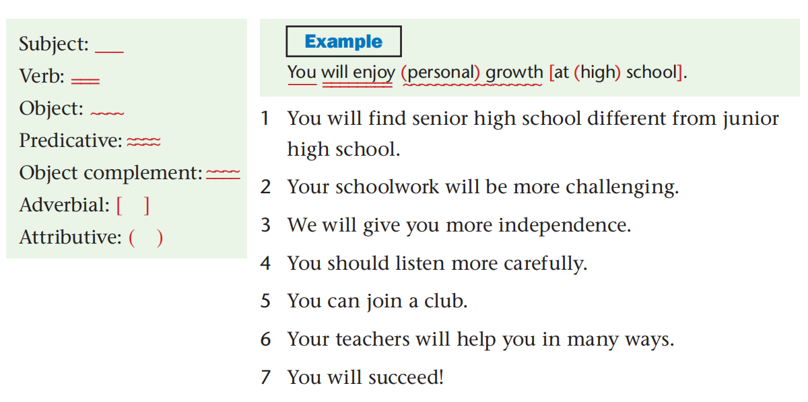
Applying the rules
Mark the different elements of each sentence with different symbols.

Slide 17
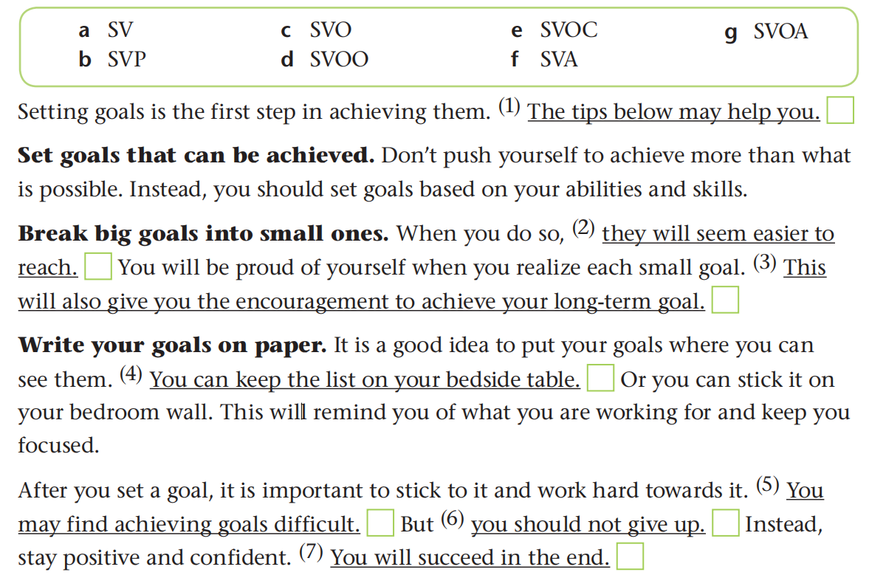
Below are some tips about setting goals. Match the underlined sentences with the correct structures. Write the letters in the boxes.

Slide 18
Correct the grammar mistakes in the following passage.
Manage time properly is an important way of leading a more successful life. You will benefit the tips below.
Keep a diary. It may seem difficult to start, but sticking to it will give the chance to see how you spend your time.
Make a to-do list. Sometimes you feel caught between so many tasks. In this case, a to-do list may helpful. You can also break big tasks into small action steps. This makes difficult tasks easily to manage and complete.
Use technology wisely. To manage your time well, you should also make wisely use of communication tools. The best way is set aside some time for dealing with them. You should not waste too much time on them.

Slide 19
Correct the grammar mistakes in the following passage.
Managing
Manage time properly is an important way of leading a more successful life. You will benefit the tips below.
Keep a diary. It may seem difficult to start, but sticking to it will give the chance to see how you spend your time.
︿
from
︿
you

Slide 20
Correct the grammar mistakes in the following passage.
Make a to-do list. Sometimes you feel caught between so many tasks. In this case, a to-do list may helpful. You can also break big tasks into small action steps. This makes difficult tasks easily to manage and complete.
︿
be
easy/easier

Slide 21
Correct the grammar mistakes in the following passage.
Use technology wisely. To manage your time well, you should make wisely use of communication tools. The best way is set aside some time for dealing with them. You should not waste too much time on them.
wise
︿
to

Slide 22

Write a short passage
What is your goal for the new term? How are you
going to achieve your goal? Write about it using
different sentence structures.

Slide 23
Presentation and evaluation
Subject + Verb (SV)
Subject + Verb + Predicative (SVP)
Subject + Verb + Object (SVO)
Subject + Verb + Indirect object + Direct object (SVOO)
Subject + Verb + Object + Object complement (SVOC)

Slide 24
A sample
Speaking in public confidently remains a challenge to me. I find it difficult to speak in public confidently. My goal for the new term is to improve my communication skills. To achieve this goal, I will encourage myself to ask and answer more questions. Joining a club also seems a great idea. I think it can offer me a good opportunity to make new friends and acquire new skills. Besides, I will read a book on how to improve communication skills. Always try hard and I will succeed!

Slide 25
Homework
Polish your writing after class and exchange your writing with other classmates.

Slide 26


