Slide 1


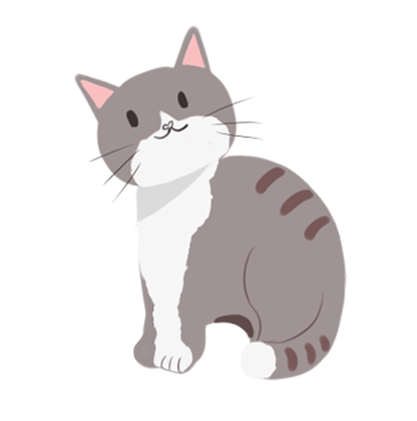

端午节
The Dragon Boat Festival

Slide 2
端午节的来历
The Dragon Boat Festival, also called Double Fifth Festival, is celebrated on May 5th on lunarcalendar. It is a folk festival widely spread with a history of over 2,000 years, and is one of the most important Chinese festivals as well. There are various celebrating activities on that day, among which the customs of eating rice dumplings and dragon boat racing are quite important.

Slide 3
端午节吃什么？
Glutinous rice filled with meat, nuts or bean paste and wrapped in bamboo leaves. It is associated with Dragon Boat Festival with historical meaning.The custom of eating zongzi is now popular in North and South Korea, Japan and Southeast Asian nations.
糯米一般先用肉、坚果或者豆沙馅填充起来，然后再用竹叶包裹起来。这是和端午节的历史意义紧密结合在一起的。吃粽子的习俗，现在已经在朝鲜、韩国、日本和东南亚国家流行开来。

Slide 4
端午节玩什么？
Dragon boat racing is an indispensable part of the festival, held all over the country. As the gun is fired, people will see racers in dragon-shaped canoes pulling the oars harmoniously and hurriedly, accompanied by rapid drums, speeding toward their destination.
赛龙舟是端午节重要的组成部分，在全国上下都会进行。枪声一响，人们就会看到龙舟上的运动员，伴随着快速的鼓点，迅速又整齐划一地划动船桨，冲向终点。

Slide 5
端午节戴什么？
On Dragon Boat Festival, parents also need to dress their children up with a sachet. They first sew little bags with colorful silk cloth, then fill the bags with perfumes or herbal medicines（草药）, and finally string them with silk threads. The sachet will be hung around the neck or tied to the front of a garment as an ornament. They are said to be able to ward off evil.

Slide 6
端午节挂什么？
Hang branches of moxa and calamus around the doors of their homes display portraits of evil's nemesis, Chung Kuei.
挂艾叶菖蒲和悬钟馗像都是为了驱疾避凶，讨个吉利。

Slide 7

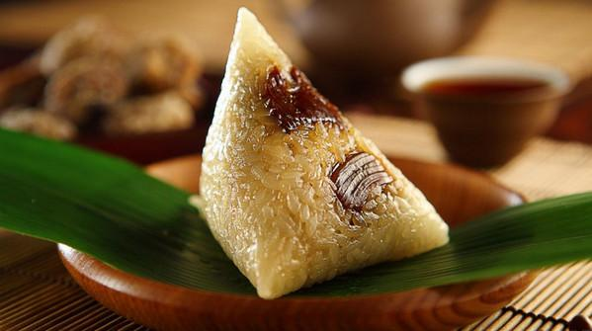
吃粽子 Eating Zongzi

Slide 8
吃粽子 Eating Zongzi
Zongzi is a kind of food made with sticky rice（糯米）and is wrapped（包裹）withreed（芦苇）or bamboo（竹）leaves. It has different shapes and fillings（馅料）. In the northern part of China, people use red jujube（枣）as fillings. In the southern part of China, people use beans, fresh meat, or egg yolk（蛋黄）as fillings.

Slide 9
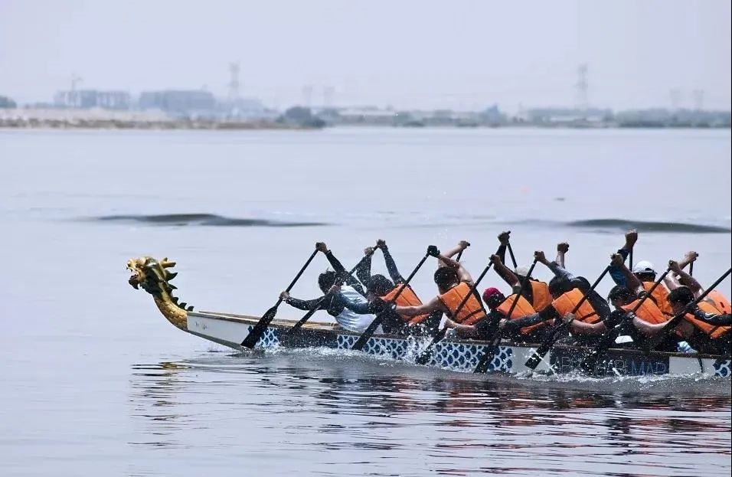
赛龙舟 Dragon Boat Racing

Slide 10
赛龙舟 Dragon Boat Racing
Dragon boat race is a traditional amusement activity in the Dragon Boat Festival.TheRaces are an indispensable part of the Dragon Boat Festival and are held all over China.
龙舟比赛是端午节的传统娱乐活动。是端午节不可缺少的一部分，在中国各地都有。

Slide 11
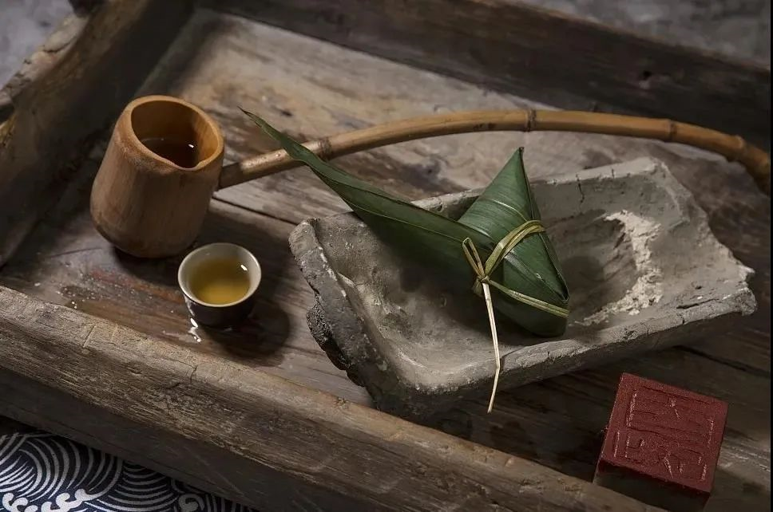
喝雄黄酒 Drinking realgar wine

Slide 12
喝雄黄酒 Drinking realgar wine
Realgar wine is Chinese liquor seasoned with realgar. It is a custom to drink the wine during the Dragon Boat Festival.
雄黄酒是用雄黄调味的中国酒。端午节喝酒是一种习俗。

Slide 13
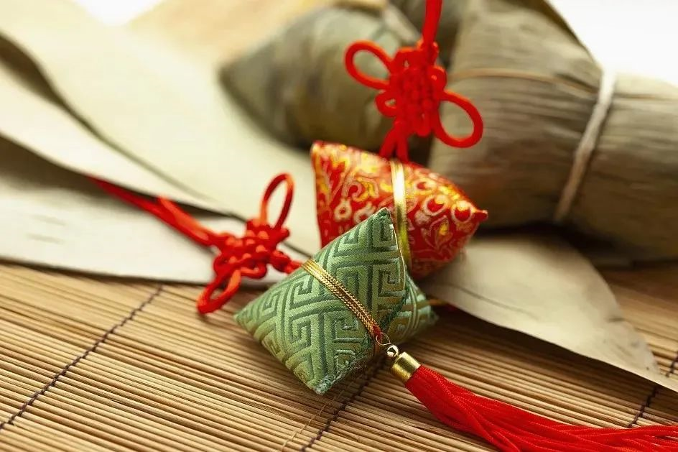
佩香囊 Wearing a sachet

Slide 14
佩香囊 Wearing a sachet
The sachet, which is said to be able to ward off evil, is usually hung around the child's neck or tied to the front of his or her garment as an ornament.
据说能驱邪的香包通常要挂在孩子的脖子上或系在他的衣服前面作为装饰品。

Slide 15
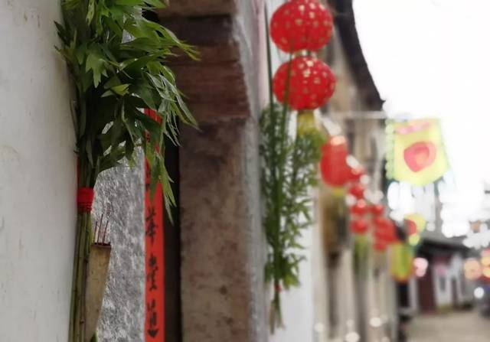
悬艾叶菖蒲 hanging mugwort and calamus

Slide 16
悬艾叶菖蒲 hanging mugwort and calamus
Ai Tsao is a kind of medicinal herb that can cure diseases. It is inserted in the doorway on behalf of Zhaobaifu and can make the owner healthy.
艾草是一种可以治病的药草，插在门口代表招百福，可使主人身体健康。

Slide 17
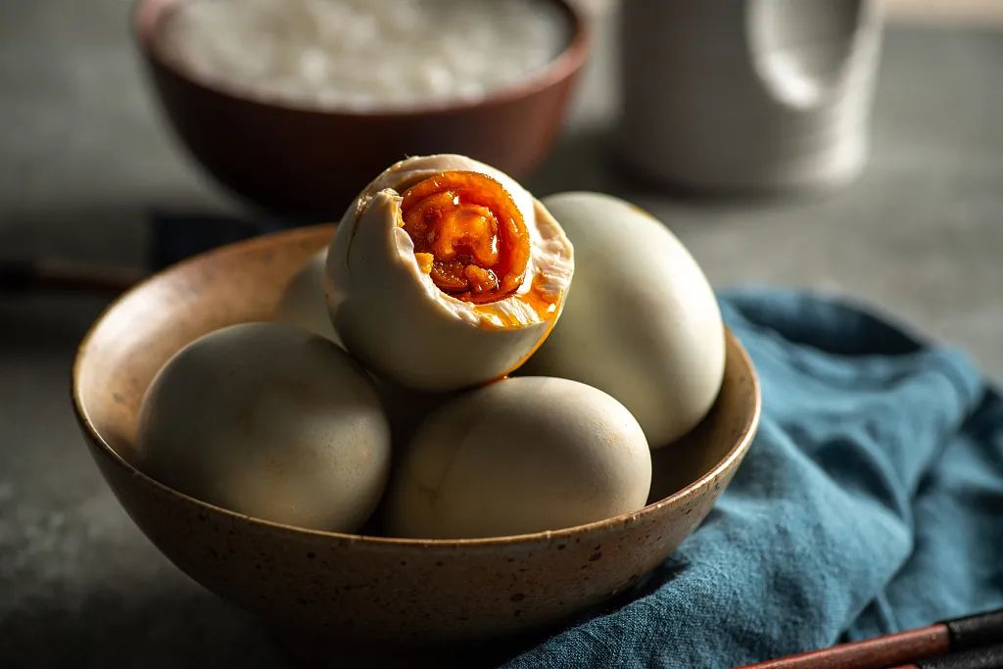
吃咸鸭蛋 eating salted duck eggs

Slide 18
吃咸鸭蛋 eating salted duck eggs
Tradition has it that it is good to eat salted duck eggs during the Dragon Boat Festival as the burning summer is coming. The salted duck eggs are nutrient-rich and have some effect on the treatment of heatstroke.
传统认为，在端午节吃咸鸭蛋有益健康，因为灼热的夏天很快就要来临了。咸鸭蛋营养丰富，对治疗中暑有一定功效。

Slide 19
端午节词汇
1. Dragon Boat Festival 端午节
2. Dragon boat race 赛龙舟
3. Sticky rice 糯米
4. Wrapped in a piece of leaf / Wrapped in leaves 包在叶子里
5. Salty(美) / Savory(英/澳) 咸的
6. Egg yolk 蛋黄
7. patriotic poet 爱国诗人
8. To commemorate Qu Yuan 为了纪念屈原
9. Lunar calendar 农历
10. Keep up the tradition 保留传统

Slide 20
端午节英语书面表达
假设你是李华，你的美国笔友Maria对中国的传统节日端午节很感兴趣，希望你给她写信介绍端午节。信中应包括以下几点：
1. 端午节是中国重要的传统节日之一；
2. 端午节的时间是每年的农历五月初五；
3. 人们庆祝端午节是为了纪念中国伟大的诗人屈原；
4. 人们在端午节吃粽子、赛龙舟；
5. 你自己对中华民族传统节日的认识。

Slide 21
Dear Maria,
I'm very happy that you are interested in Chinese culture,especially the festivals.Now let me tell you something about the Dragon Boat Festival.The Dragon Boat Festival,also called the Duanwu Festival ,is celebrated on the fifth day of the fifth month according to the Chinese calendar.People always eat rice dumplings and watch dragon boat races to celebrate it.
The festival is best known for its dragon-boat races,especially in the southern places where there are many rivers and lakes. It’s very popular.
The rice dumpling is made of glutinous rice,meat and so on. You can eat different kinds of rice dumplings.They are very delicious.
And Dragon Boat Festival is for Qu Yuan. He is an honest minister who is said to have committed suicide by drowning himself in a river.
Overall, the Dragon Boat Festival is very interesting!
Your friend
Li Hua

Slide 22
端午节英语书面表达
假定你是李华。端午节即将到来，请你写一封信邀请加拿大留学生Peter来你家过端午节。信的主要内容包括：
1. 表达你诚挚的邀请；
2. 对端午节做简单介绍；
3. 介绍你家乡的庆祝活动。
注意：1. 词数100左右；
2. 可适当增加细节，以使行文连贯。

Slide 23
Dear Peter,
I would like to extend a heartfelt invitation to you. Since the Dragon Boat Festival is around the corner, I sincerely invite you to my home to have a happy time together.
The Dragon Boat Festival is one of the major festivals in China. The Dragon Boat Festival, also called the Duanwu Festival, is celebrated on the fifth day of the fifth lunar month. For thousands of years, the festival has been marked by eating zongzi and racing dragon boats.
You have told me many times in your letters that you are fond of boating. Now I am sure that your dream will come true soon, because there will be a dragon boat race in my hometown during the Dragon Boat Festival.
I’m looking forward to your reply.
Yours,
Li Hua

Slide 24
端午节英语书面表达
假定你是王明，计划和同学骑自行车去西湖过端午节（the Dragon Boat Festival)。请给外教Lucy写封邮件，邀她一同前往，内容包括：
1. 出发及返回时间；
2. 活动：吃粽子(rice dumpling)、观看龙舟比赛等。
注意：
1.词数100左右；
2.可以适当增加细节，以使行文连贯；
3.结语已为你写好。

Slide 25
Dear Lucy,
I’d like to invite you to join us to cycle to the West Lake next Saturday for the Dragon Boat Festival.
The Dragon Boat Festival is in memory of the death of the famous ancient poet, Qu Yuan. There will be a variety of activities such as eating rice dumplings, throwing rice dumpling into the river and so on. We’ll also spend some fun time together watching the dragon boat race, which will make us experience Chinese traditional culture. We should be back around 6 o’clock in the afternoon.
If you are able to come with us, please let us know and we’ll wait for you at the school gate at 9 in the morning.
Looking forward to your early reply.
Yours,
Wang Ming

Slide 26
THANK YOU

