Slide 1


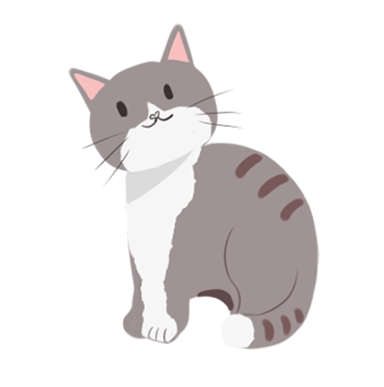
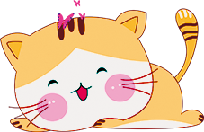
中秋节
The Mid-Autumn Festival

Slide 2
What is Mid-Autumn Festival?
The Mid-Autumn Festival, also known as the moon worship Festival, celebrated on August 15 of the lunar calendar every year. Since ancient times, the Mid-Autumn Festival has folk customs such as sacrificing the moon, appreciating the moon, eating moon cakes, playing lanterns, appreciating osmanthus, drinking osmanthus wine and so on. The Mid-Autumn Festival symbolizes people's reunion like the full moon. In order to place the feeling of missing hometown and relatives, and pray for harvest and happiness, it has become a colorful and precious cultural heritage.

Slide 3
How the Chinese Celebrate Mid-Autumn？
Many traditional and meaningful celebrations are held in most households in China, and China's neighboring countries. The main traditions and celebrations include eating mooncakes, having dinner with family, gazing at and worshipping the moon, and lighting lanterns.
大部分中国家庭以及中国的邻国都会举行许多传统的庆祝活动，主要庆祝方式包括吃月饼，吃团圆饭，赏月和点灯笼。

Slide 4
The origin of the Mid Autumn Festival
The Mid Autumn Festival originated in ancient times, popularized in the Han Dynasty, shaped in the early Tang Dynasty and prevailed after the Song Dynasty. The Mid Autumn Festival is a traditional cultural festival popular in China and the Chinese areas of the world. The Mid Autumn Festival, the Spring Festival, the Qingming Festival and the Dragon Boat Festival are known as the four traditional festivals in China.

Slide 5

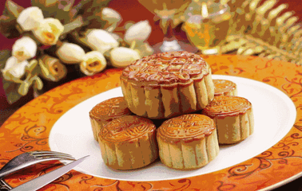
Eat Moon Cakes 吃月饼

Slide 6
Eat Moon Cakes 吃月饼
This is the most popular Mid-Autumn Festival activity. Mooncakes are cookies with various fillings like nuts, red bean paste, lotus root paste, egg yolk, meat, and fruit, etc. They are usually round to symbolize the full moon and family reunion.

Slide 7
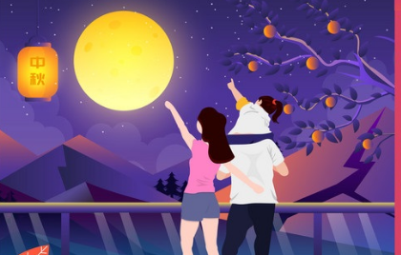
Appreciate the Full Moon 赏月

Slide 8
Appreciate the Full Moon 赏月
In traditional Chinese culture, the moon on the festival night is believed to be the fullest and brightest of the whole year, symbolizing family reunion. Even a family member is not home, he or she is appreciating the same moon with other families, seeming like they are together.

Slide 9
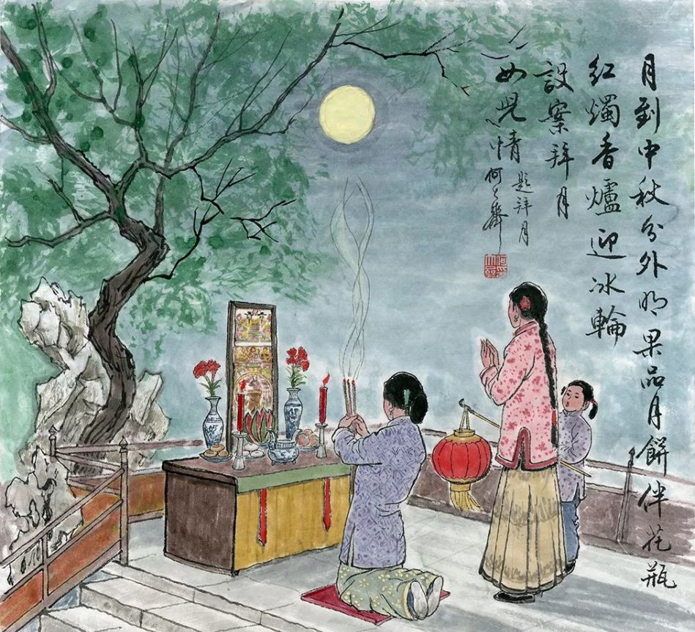
Worship the Moon 祭月（拜月）

Slide 10
Worship the Moon 祭月（拜月）
This tradition has been 3,000 years old. On the night, people set a table with mooncakes and other sacrifices towards the moon, make wishes, offer incense and kowtow to the moon. Afterwards, the families will share the sacrifices.

Slide 11
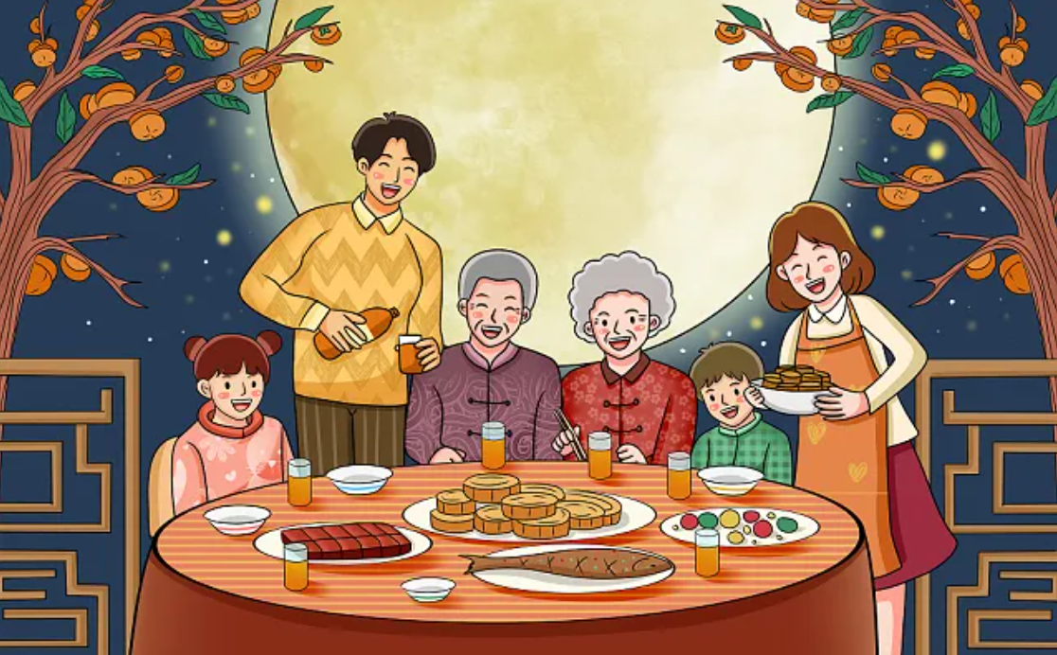
Enjoy Family Reunion Dinner 吃团圆饭

Slide 12
Enjoy Family Reunion Dinner 吃团圆饭
During the festival, all families try their best to go home and enjoy a big feast. In addition to mooncakes, other popular dishes for the reunion dinner include osmanthus cake, osmanthus wine, crab, duck, taro, and pumpkin.

Slide 13
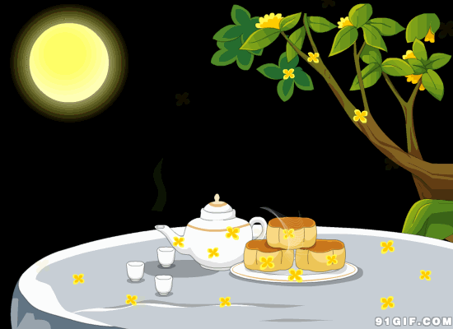
Drink Osmanthus Wine 饮桂花酒

Slide 14
Drink Osmanthus Wine 饮桂花酒
Around the festival, the Osmanthus is always in full blossom, making it a good time to make and drink osmanthus wine. It is light yellow with strong osmanthus fragrance and grape similar flavor, tasting sweet, sour and soft.
节日前后，桂花怒放，是制作和饮用桂花酒的好时机。桂花呈淡黄色，花香浓郁，有点像葡萄的味道，尝起来又甜又酸又软。

Slide 15
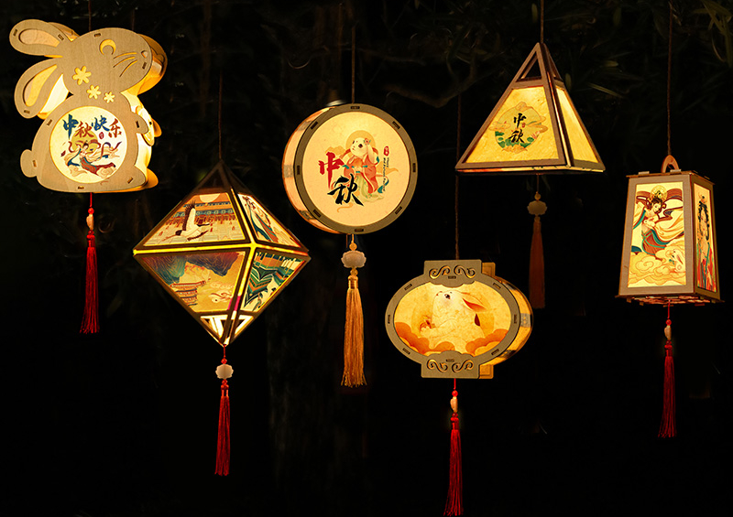
Make and Hang Festival Lanterns 扎灯笼

Slide 16
Make and Hang Festival Lanterns 扎灯笼
Make and Hang Festival LanternsThis is an activity popular in Guangdong and Hong Kong areas, favored especially by kids. In other places of China, people also set Kongming lanterns to make best wishes.
制作和悬挂节日灯笼这是一项在广东和香港地区很流行的活动，尤其受到孩子们的喜爱。在中国的其他地方，人们也会放孔明灯来表达美好的祝愿。

Slide 17
月饼种类
传统月饼：（Traditional styles）
广式月饼：（Cantonese-style moon cake）
苏式月饼：（Suzhou-style moon cake）
京式月饼：（Beijing-style moon cake）
滇式月饼：（Yunnan-style moon cake）
创新月饼：（Contemporary Styles）
低糖月饼：（low-sugar moon cake）
无脂月饼：（fat-free moon cake）
冰皮月饼：（snow skin moon cake）
水果月饼：（fruits moon cake）

Slide 18
月饼口味
Sweet bean paste（豆沙）
Date paste（枣泥）
Mung bean （绿豆）
Black sesame paste （黑芝麻)
Lotus seed paste （莲蓉）
Durian （榴莲）
Five kernel（五仁）
五仁是指花生（peanut）， 核桃（walnut seed），
瓜子（watermelon seed）， 杏仁（almond），
松子（pine nut）。

Slide 19
中秋节相关英文词汇
mooncake molds 月饼模具
guardians 守护者 fireball 火球
origin of mooncake festival 中秋节的起源
scorch the earth 灼烧大地
sharpshooter 射击名手；狙击手
shoot down something 射下来...
excess 额外的 command 要求，命令
benefit the people 受益百姓
immortal 长生不老的 make sb a god 封神
reluctant 不情愿的 elixir 不老长寿药

Slide 20
中秋节相关英文词汇
evil-minded 坏的，邪恶的 archery 射箭术
go out for something/doing something 外出做某事
bring (disasters) to (human being) 给（人类）带来（灾难）
disciple 徒弟 swallow 吞下
moon goddess 月神
be accompanied by 由...陪伴
jade rabbit 玉兔 jade 碧玉；玉制的
reunite with sb 与某人团聚
pass something from generation to generation 世代相传某物
Mid-Autumn Festival

Slide 21
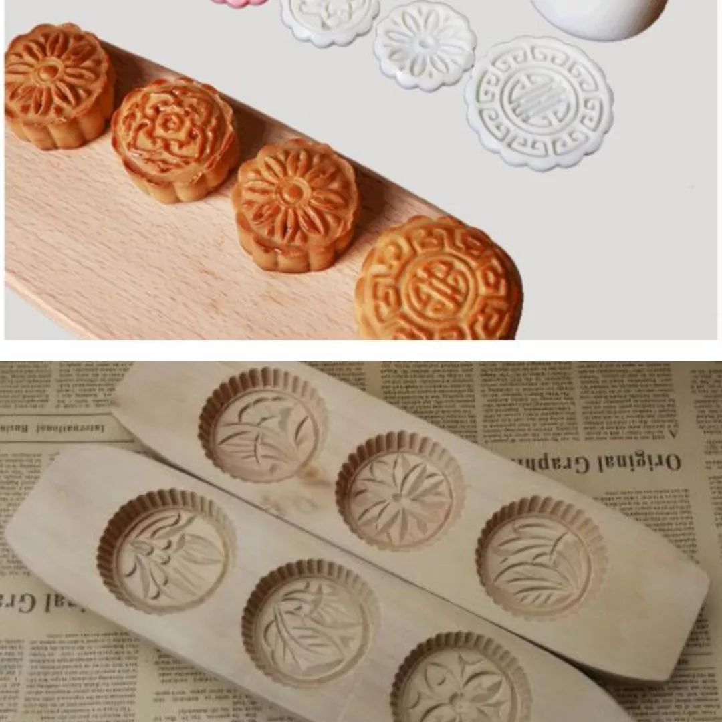
中秋节相关英文词汇
The Mid-Autumn Festival 中秋节
Mooncake 月饼
appreciating the moon 赏月
fire dragon dances火龙舞
Chang-E 嫦娥
jade rabbit / hare 玉兔
sky lantern孔明灯
cassia wine 桂花酒
the Chinese lunar calendar 中国农历
lantern riddles 灯谜

Slide 22
中秋节相关英文词汇
Mid-Autumn Festival is a traditional Chinese festival. It is>中秋节 是中国的传统节日，时间是中国农历八月十五。
On that night, families eat moon cakes and enjoy the glorious full moon; the moon cake is round and looks like the full moon.
那天晚上，家家户户都边吃月饼 边赏月，当天是圆月，月饼便做成圆的，看上去像满月。
As for mooncakes, everyone has their own favorites. And we've already stuffed our faces with plenty kinds of mooncakes by the time the festivities arrive.
对于月饼，每个人都有自己的喜好，并且在庆祝活动到来的时候，我们已经享尽了 各种各样的月饼。

Slide 23
中秋节常用祝福语
Happy Mid-Autumn Day! Wish that you go well and have a successful and bright future.
中秋节快乐，万事如意，心想事成！
Wish you a perfect life just like the roundest moon in Mid-Autumn Day. 愿你的生活就象这十五的月亮一样，圆圆满满。
Wishing us a long life to share the graceful moonlight, though thousands of miles apart.
但愿人长久，千里共婵娟。
I want to make a toast. I Wish that the round moon take my best blessing to you. May you have a happy family and a bright future.
举杯遥祝：月圆人圆花好，事顺业顺家兴。

Slide 24
THANK YOU

