Slide 1

Unit 1 Back to school
Integrated skills (I)

Slide 2


Free talk
What is your feeling about your new school life?

Slide 3
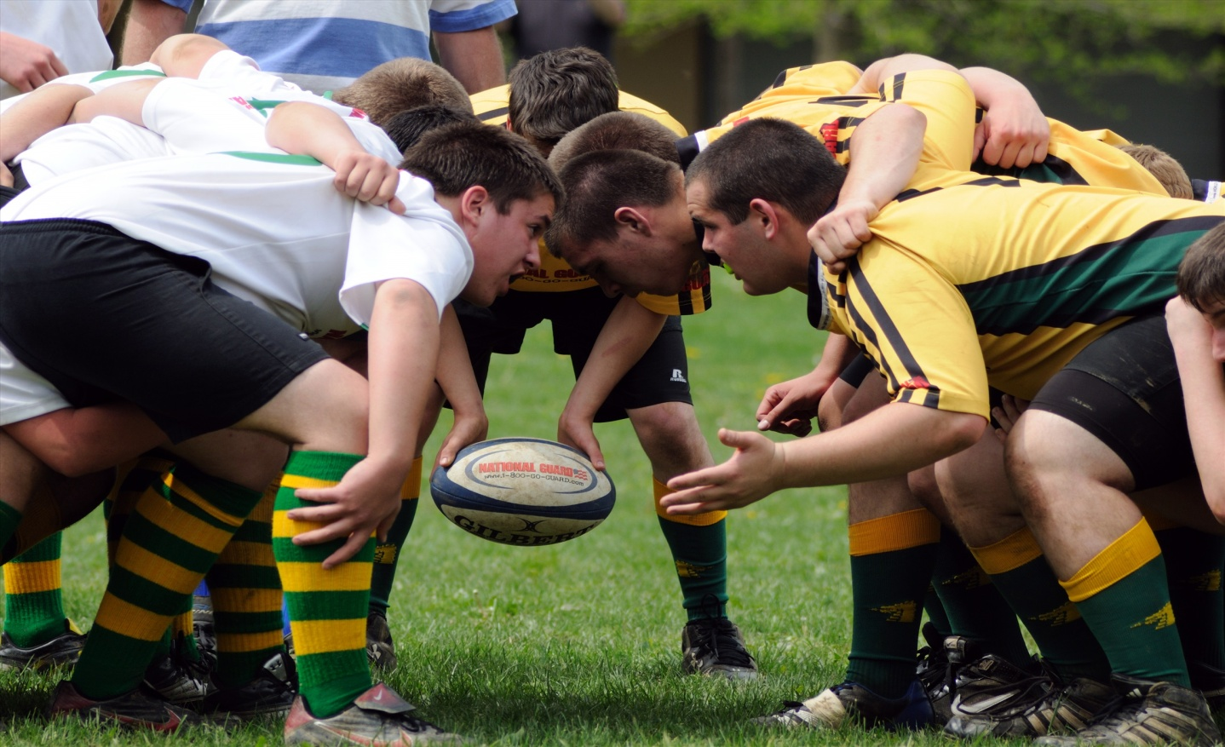
Do you want to join any school club?
If possible, what kind of club do you want to start?
Do you know how to start a club?

Slide 4
Pre-listening
Guess the relationship between Maggie and Mr Zhou.
Go through the steps of part A1 and circle the key information.
Put the steps in your own order.

Slide 5
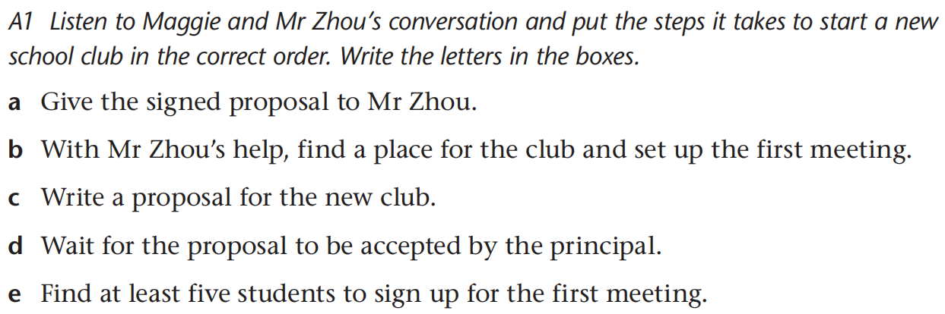
Pre-listening
Your order is ___________________.

Slide 6


While-listening
Listen and check.
c e a d b

Slide 7
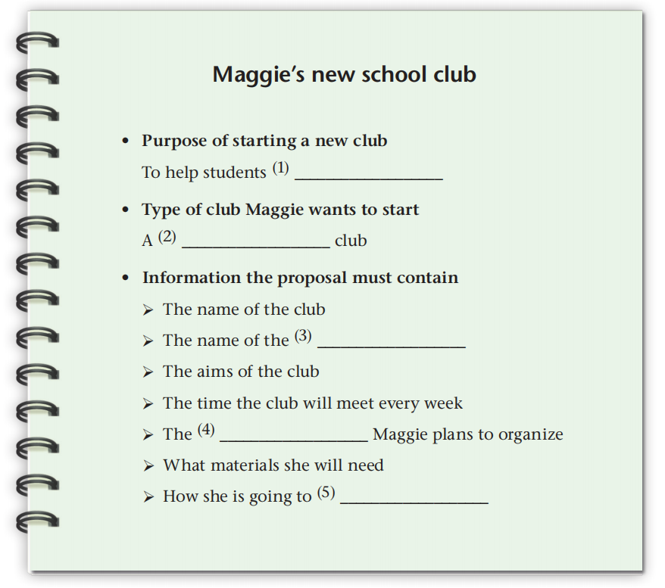
While-listening
Listen again and complete the notes,
learn a useful skill
short story writing
club leader
activities
find new members
1. ________________
2. ________________
3. ________________
4. ________________
5. ________________

Slide 8
While-listening
Listen for emotions and personalities
according to the wording and their intonation.
 | Identity | Personality
Maggie | student | respectful, …
Mr Zhou | … | …

Slide 9
Post-listening
Who?
What?
How?
Retelling
the main points
Prediction
Intonation
Note-taking
Summarizing
listening strategies

Slide 10
Before reading
Predict what Maggie’s proposal covers
Club name
Club leader
Club aim
Anything else?

Slide 11

Critical reading
Compare your version with Maggie’s proposal.
Any difference? Which is better? State your reasons.

Slide 12
Reading for the structure
Title
Club name
Club leader
Meeting time
Club aim
Club activities
Materials needed
Plan for finding new members
Signature

Slide 13
Self-assessment
( ) Q1: Have you got a clear idea of how to start a school club?
( ) Q2: Do you have a good understanding of the structure of the proposal?
( ) Q3: Do you have any difficulty in words and expressions on pages 8－9?
A. Absolutely yes. B. Not really. C. I am not sure.

Slide 14
Homework
Collect some information about the club you join.
Underline important expressions of pages 8－9 and review them.

Slide 15


